Slide 1
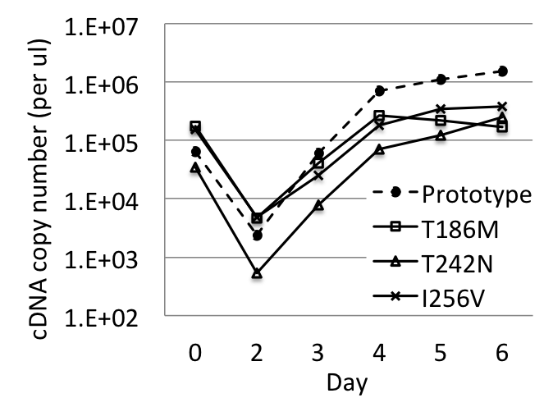
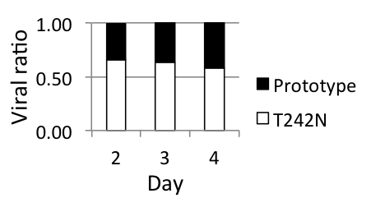
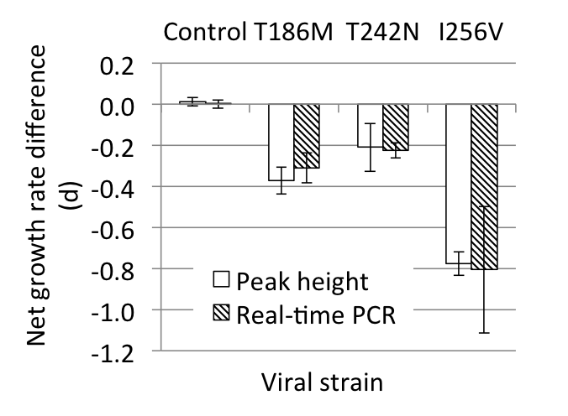
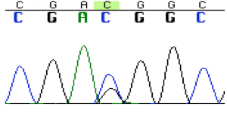
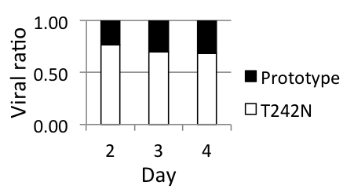
P1
PCR cloning
Site-directed
mutagenesis
P2
Harvest
TCID₅₀
Transfection
Prototype
T186M
T242N
I256V
pNL4-3
COTB-p24 vifA
*
pNL4-3
vifA
pNL4-3
COTB-p24 vifA
COTB-p24
COTB-p24
1
2
3
4
5
6
7
8
9
10
11
12
A
3-fold serial dilution
B
C
D
E
F
G
H
Mock
P3
Inoculation
(MOI = 0.005)
P4
Inoculation
(MOI = 0.005)
50:50 ratio
Sampling
RT-qPCR
Sampling
d2 d3 d4 d5 d6
d2 d3 d4
Mutant (VifA)
Prototype (VifB)
Day 0 sample
qPCR
*
vifB
P5
*
*
vifA
RNA isolation and
cDNA synthesis
d2 d3 d4
samples
C G A C/T G G C
PCR and Sanger sequencing

