Slide 1
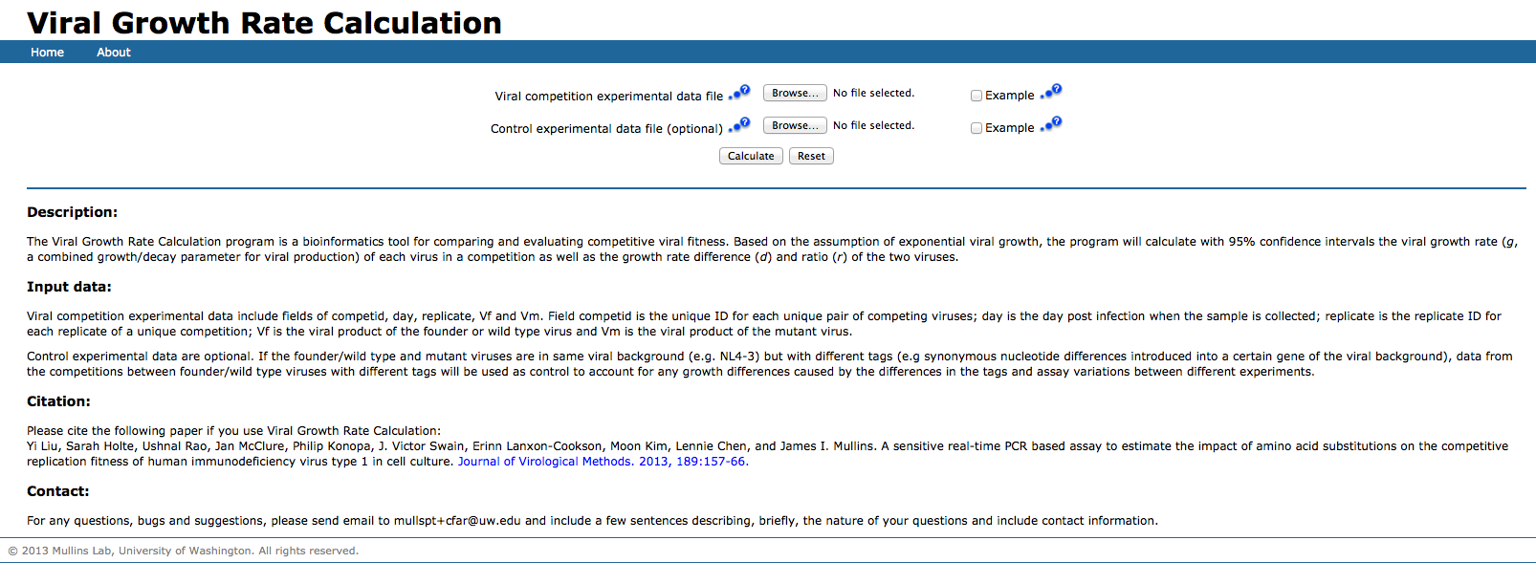
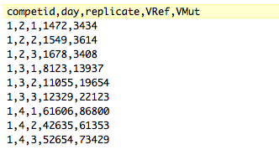
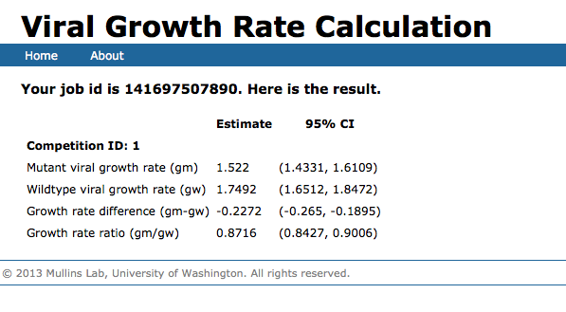
http://indra.mullins.microbiol.washington.edu/grc/
Input: cDNA copy number from RT-qPCR
Output: Net growth rate difference (d) between two competing viral strains

