Slide 1
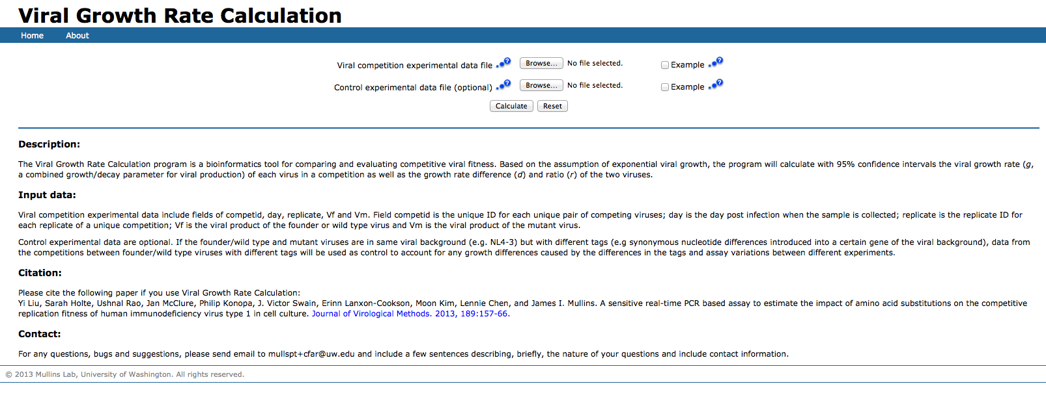
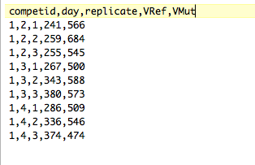
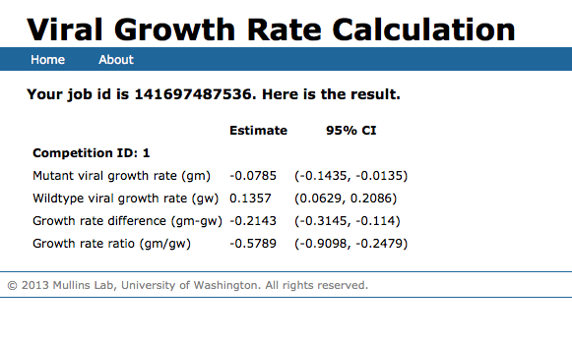
http://indra.mullins.microbiol.washington.edu/grc/
Input: Chromatogram
peak-height from Sanger sequencing
Output: Net growth rate difference (d) between two competing viral strains

