Slide 1
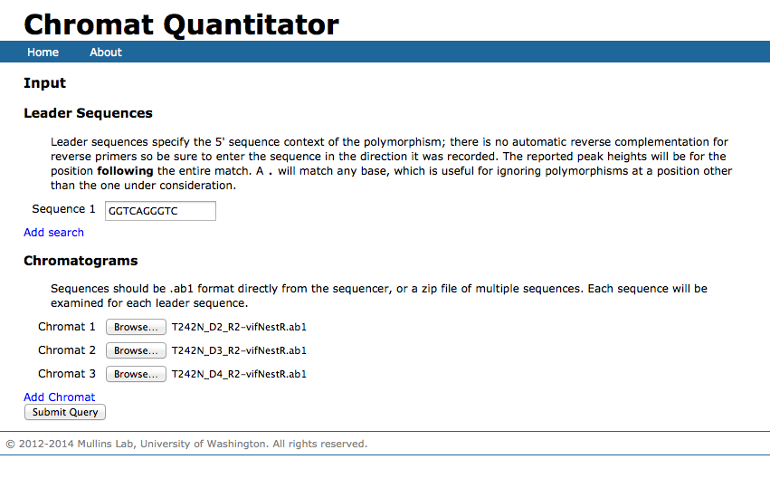
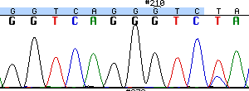
http://indra.mullins.microbiol.washington.edu/cgi-bin/chromatquant.cgi

Slide 2
