Slide 1
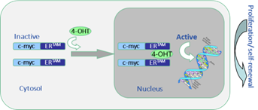

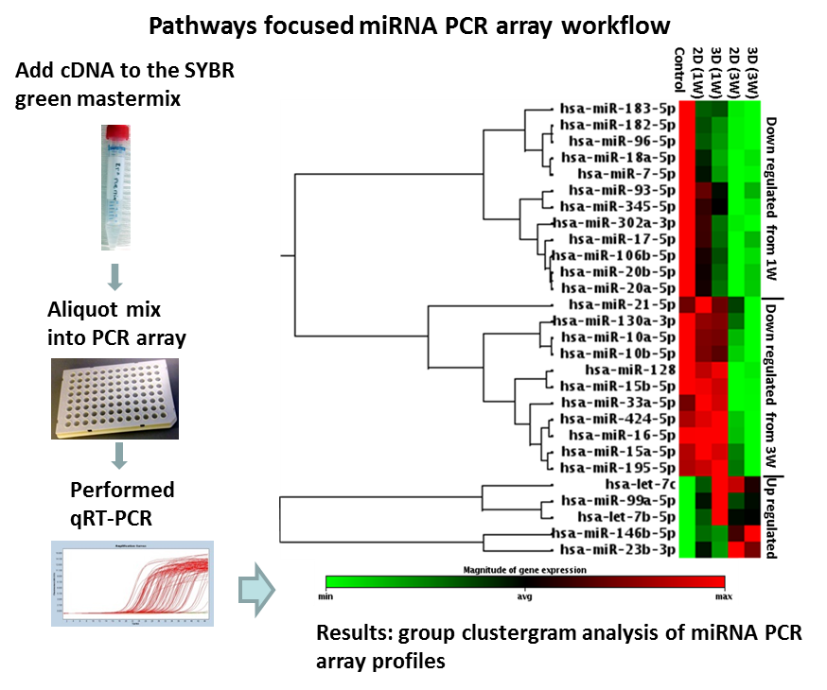
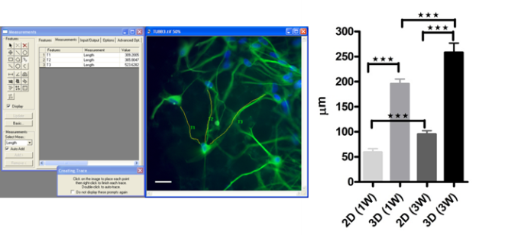
Human neural stem cells, obtained from a 12 week gestation cortical tissue and conditionally immortalized using the c-mycER^{TAM} technology, were seeded on
P1
3D cultures
Measurement of differentiation by axon process outgrowth and miRNA profiling by PCR miRNA array
P2
P3
Measurement of axon process outgrowth

Slide 2


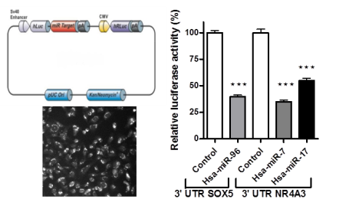
Computational analysis for miRNA target prediction
P4
Validation of target mRNA by reporter plasmid transfection and dual luciferase assay
P5

