Slide 1
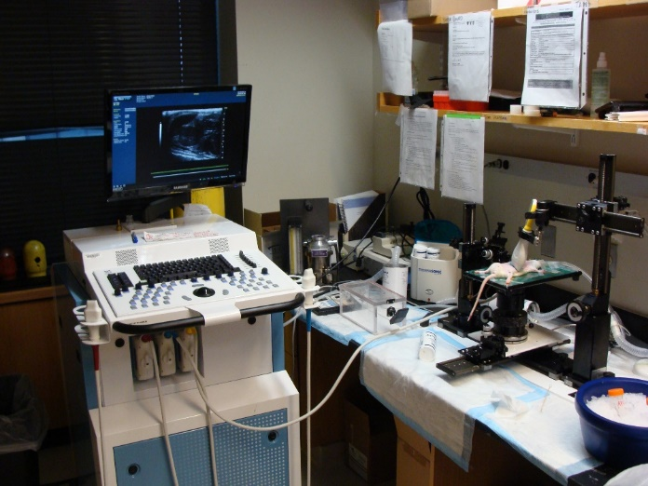
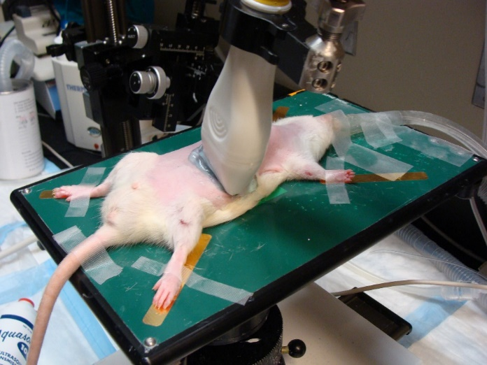
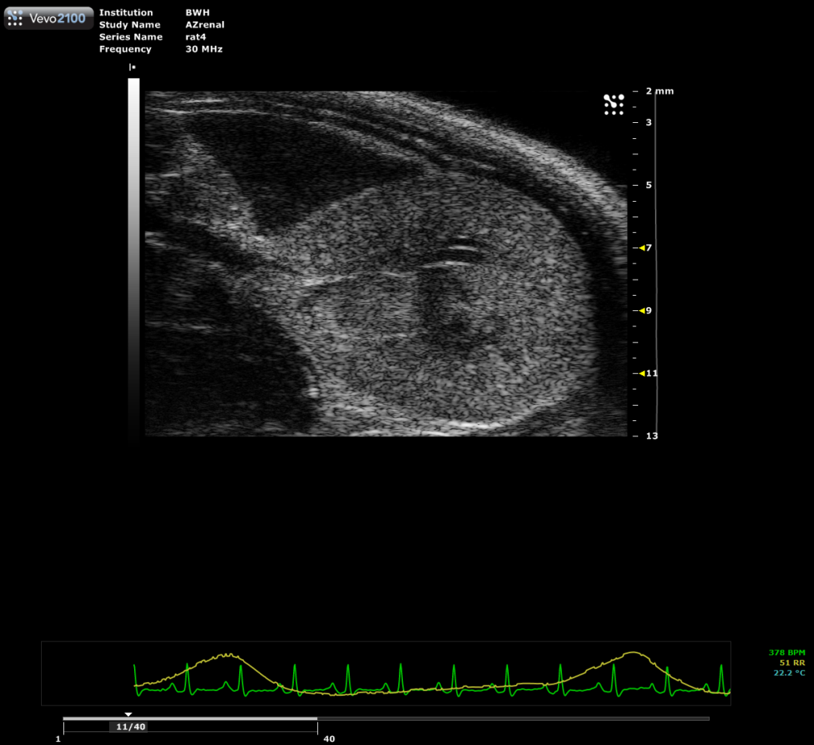
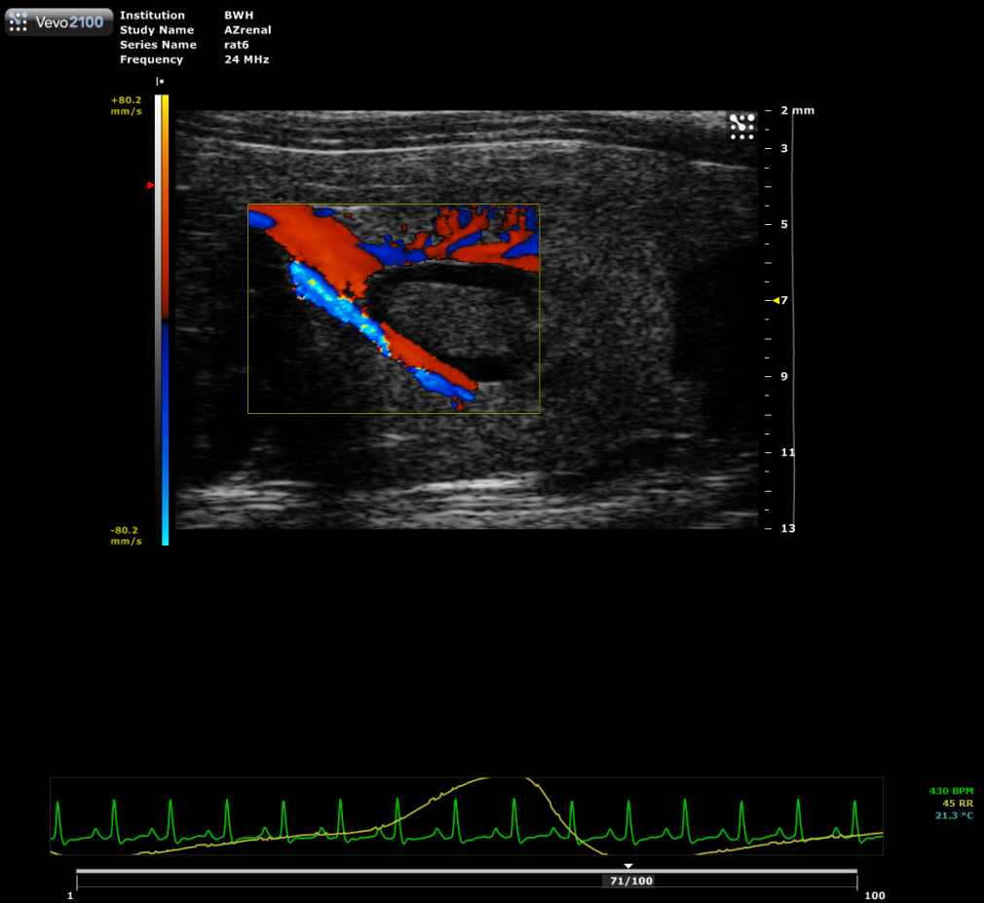
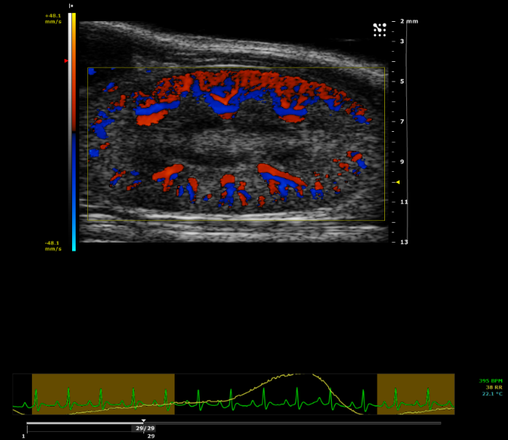
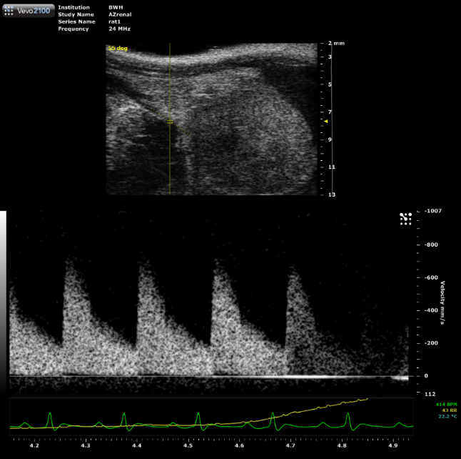
Figure 1. Ultrasound apparatus settings for detecting kidney images in rats
(A)
(B)
(C)
(D)
Renal artery
Renal pelvis
Renal pelvis
Renal artery
Cortex
Cortex
(E)
(F)

Slide 2
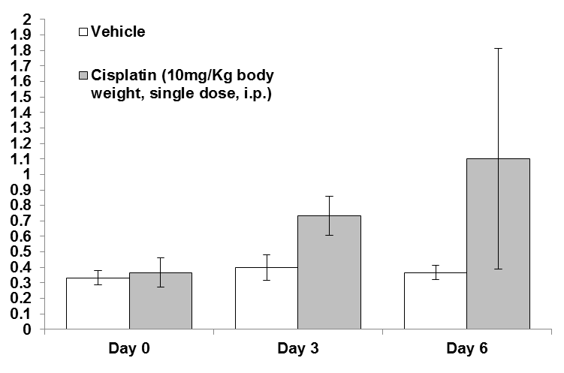
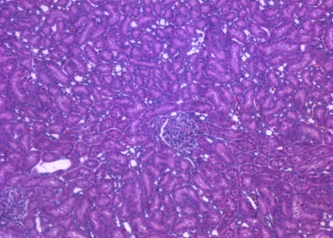
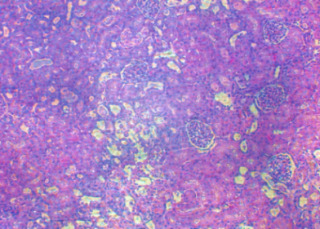
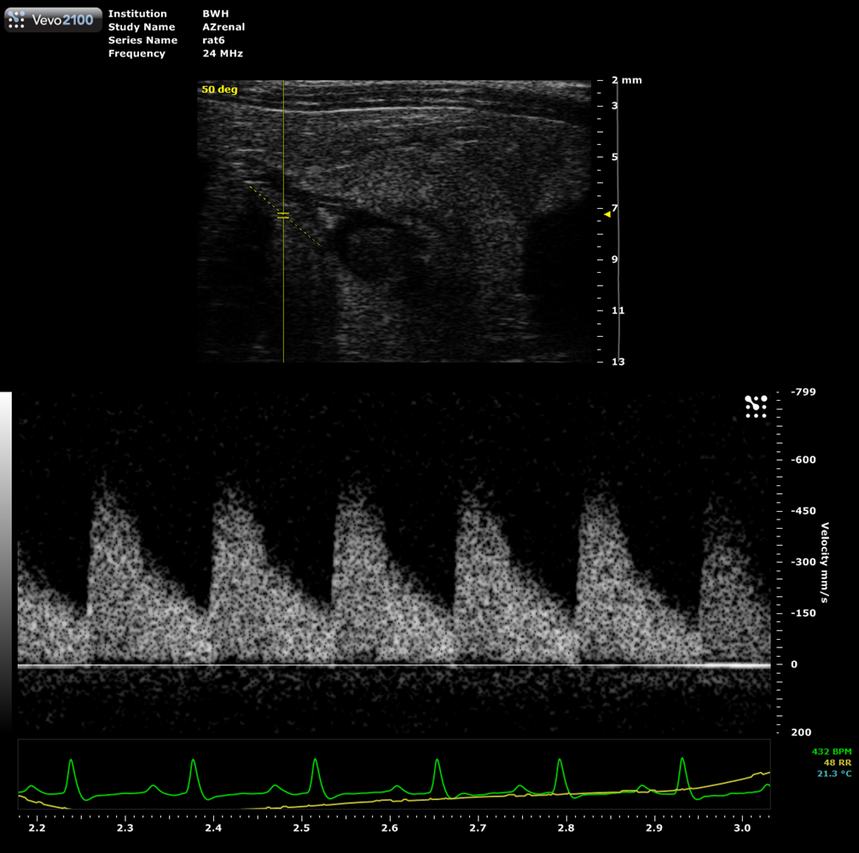
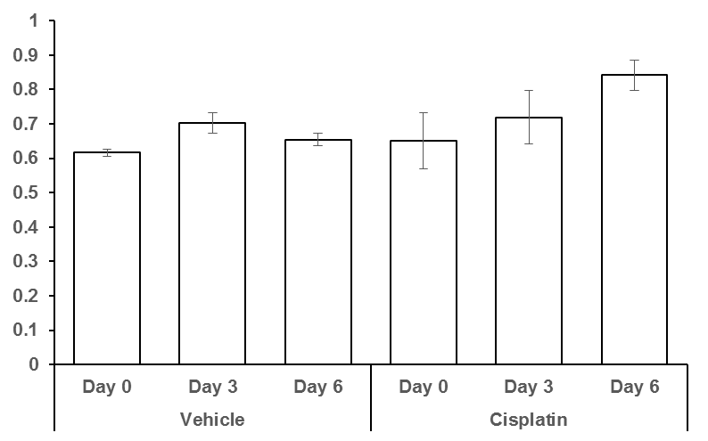
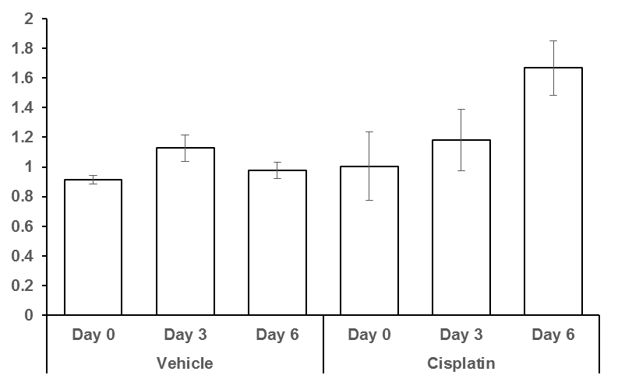
Figure 2. Creatine, Histology and Kidney sonographic images of rats under Cisplatin treatment
(A)
(B)
(mg/dl)
Creatinine
(40X)
(40X)
Vehicle Cisplatin
(C)
Day 0 Day 3 Day 6
Vehicle
Cisplatin treated
(D)
*
(E)
*
RI
PI

