Slide 1
Notes:
Create a resection

Slide 2
Notes:
Create a resection in bone portion (red)

Slide 3
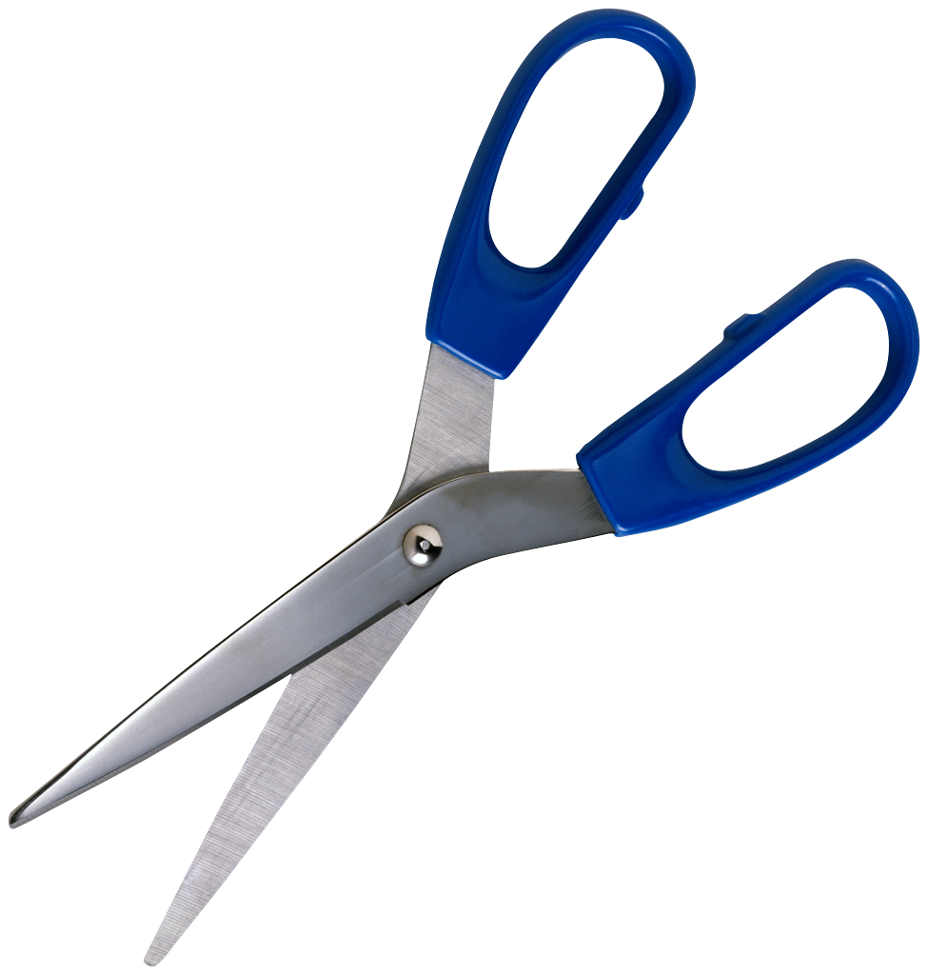
Notes:
Show lengthwise along surface to cut of grey material
Show piece getting cut at one end with scissors (need surgical ones, not office ones), one end being lifted out, other end cut with scissors
Close with sutures (not sure how to animate this or maybe don't bother?)
Animate the bone repairing (red fading back in is fine)

Slide 4
Notes:
Cross-section options: Removing the rib and the periosteum

Slide 5
Notes:
Cross-section options: Create an incision through skin, fat, and muscle. Remove the rib leaving the periosteum behind in the animal

Slide 6
Notes:
Suture closed.

