Slide 1
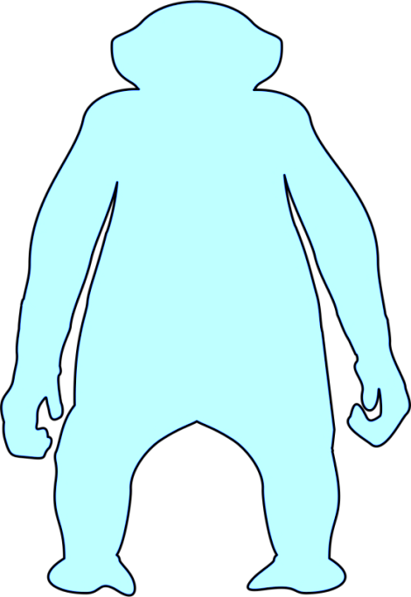
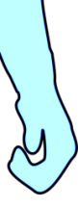


Induction of tolerance by mixed chimerism or other preclinical anti-rejection protocols

