Slide 1
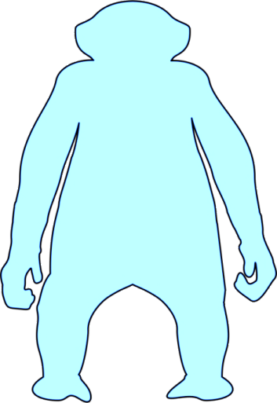



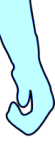
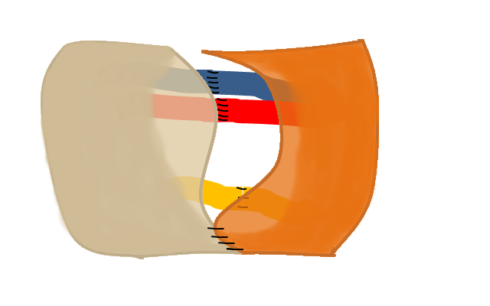
Reperfuse hand via microvascular anastomosis of radial artery, cephalic vein
Flush & cool donor hand
Procure donor hand
Experimental follow up
Transplant hand
Complete transplantation (tendons, nerves, skin)

Slide 2

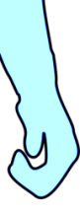


Induction of tolerance by mixed chimerism or other preclinical anti-rejection protocols

Slide 3

