Slide 1
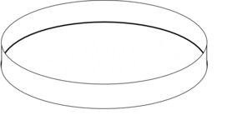



P1
Cell Plating and transfection
+
SH-5YSY
cells
Glass
Coverslip
24hrs
DNA
PEI
+
After 24-48h
Non-Transfected cells
Transfected cells
Notes:
Section 1: Cell Plating and Transfection
Cells plating onto glass coverslips and transfection with pH-sensitive fluorescent probes selectively targeted to synaptic vesicles. Protein expression is expected within 24-48 hours.
1

Slide 2
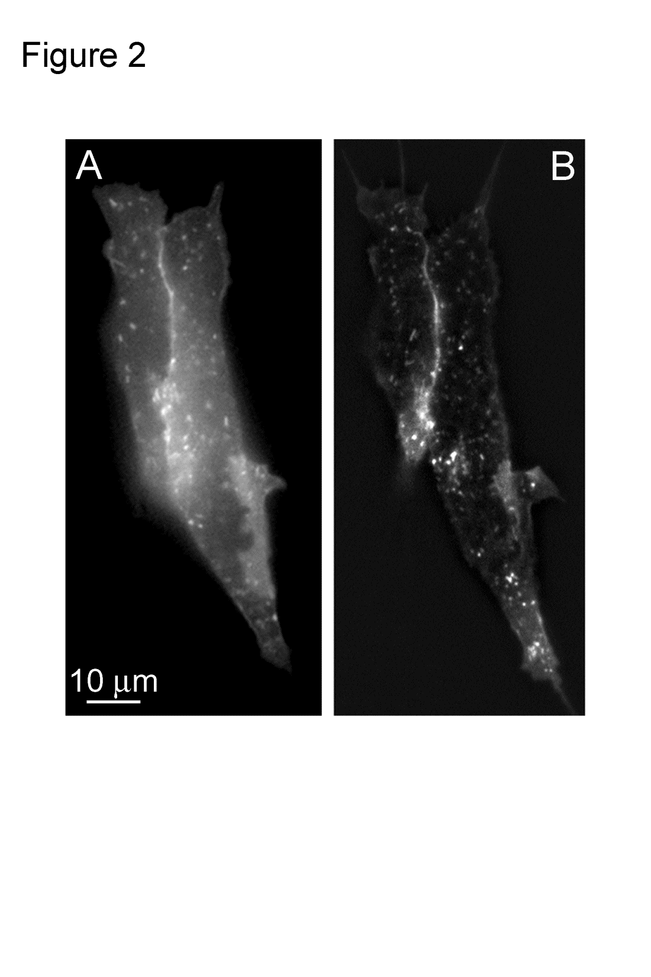



P2
Reaching TIRF configuration
Epifluorescence
Total Internal
Reflection Fluorescence
Image
TIRFM
Sample
Cover
Infinite
Sample
<100 nm
Evanescent
field
Objective
Coverslip
Rotate TIRFM
Slider Screw
0 °Angle
> Critical Angle
Notes:
P3: reaching TIRFM configuration
The second step is to record vesicle dynamics by total internal reflection microscopy. This step is particularly critical for the success of the experiment and a step-by-step description on how to achieve TIRF configuration is provided
2

Slide 3

P3
Recording in TIRF configuration
+KCl
Basal Condition
Stimulated Condition
Notes:
P3: recording in TIRF configuration
Next, once the correct TIRF configuration is reached, the sequential images can be automatically recorded by the software, in basal or stimulated conditions.
3

Slide 4
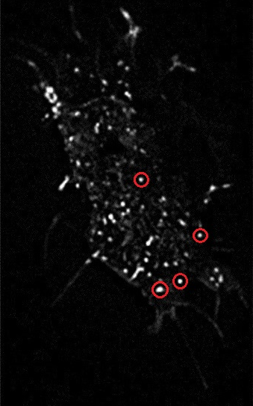
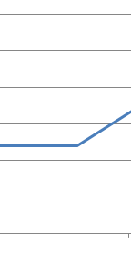
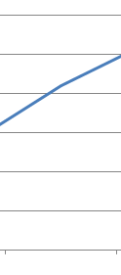
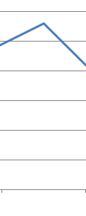
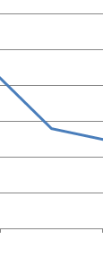
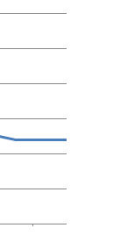



P4
Data Analysis
Notes:
P4 Data Analysis
The final step is to process images and extract data from the videos using commercial software or home-made algorithms.
4

Slide 5


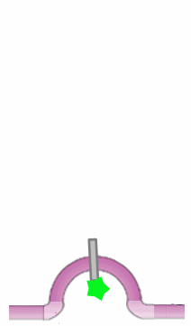


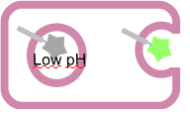

P5
Principle
Data Interpretation
KCl
Synapto-pHluorin construct
Synaptobrevin
pHluorin
Neutral pH
Notes:
P5 Data Interpretation
Ultimately, using TIRFM to record the changes in the fluorescent signal deriving from vesicle fusion to the plasma membrane, information on the frequency of fusion events and the mode of vesicle fusion to the plasma membrane can be obtained.
5

Slide 6
Cell Imaging and data analysis
Cell Plating
Cell Transfection
Day 1
Day 2
Day 3-4

