Slide 1
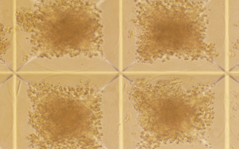
P1 : This is accomplished by first generating homogenous EBs of defined sizes by using microwell technique.

Slide 2
P2: The second step is to harvest EBs and initiate directed differentiation of iPS cells towards retinal lineage.

Slide 3
P3: Next , the iPS-RPE cells are identified and isolated.

Slide 4
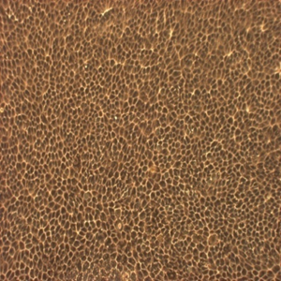
P4: The final step is to enrich and expand the iPS-RPE cells.

