Slide 1
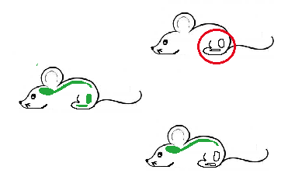
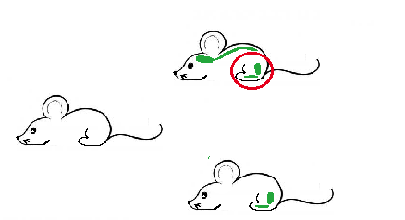
Chimeric mouse with
labeled microglia
Chimeric mouse with labeled bone marrow

