Slide 1




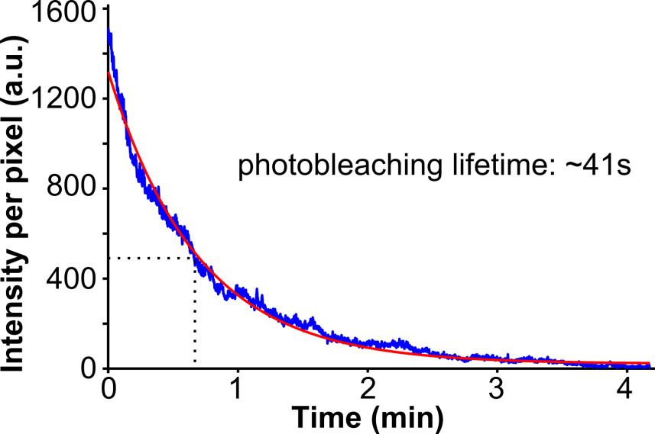
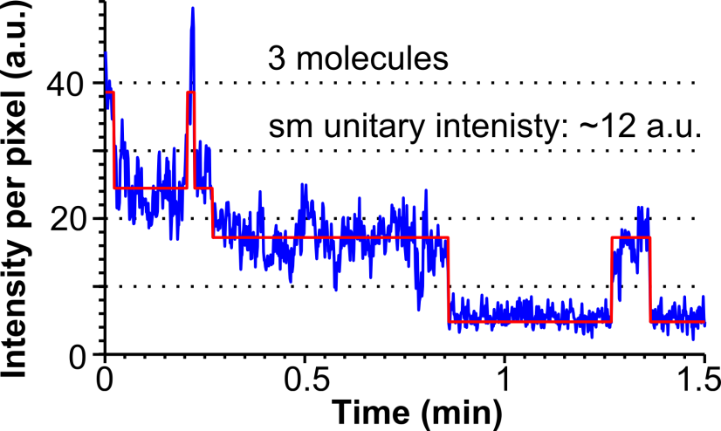
A
Heavily loaded cells (>100 molecules per cell)
→ Information on photostability
B
Cells loaded with <10 mol
→ Information on brightness, copy number

