Slide 1
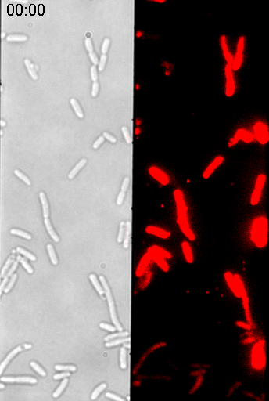
Movie 1
Notes:
One of our first test was to check that electroporated and loaded cells were still alive.
It appeared to us that one of the best test would be to see if cells could still divide after electroporation.
So we loaded some cells, in this case with a red labelled DNA, and looked at them for several hours on an agarose pad at 37°C.
As you can see in this GIF animated movie, most of the cell divide and at the end of our experiments, the pad is completely covered.

