Slide 1
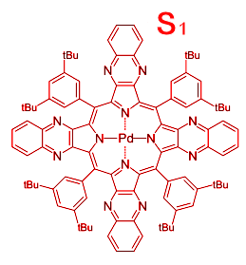
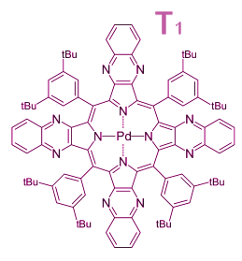
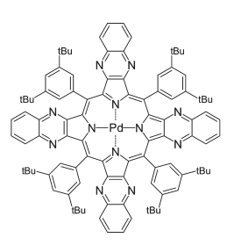
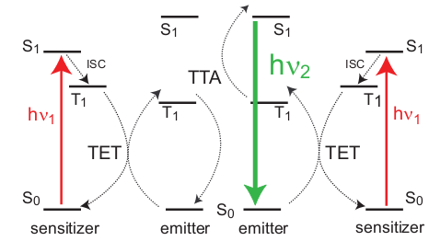
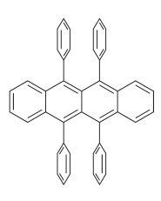
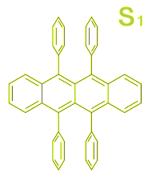
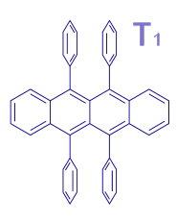

Slide 2
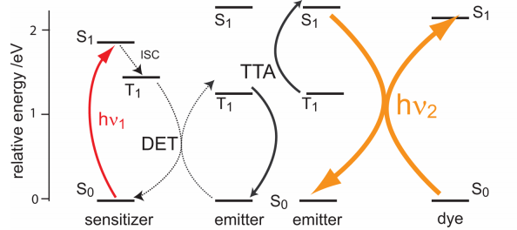
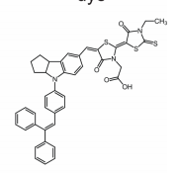
O
CH₃
tBu
tBu
N
N
N
S
S
S
N
tBu
N
tBu
O
N
N
N
O
N
Pd
N
OH
N
N
N
tBu
tBu
N
N
tBu
tBu

Slide 3
tBu
tBu
N
N
tBu
N
tBu
N
N
N
Pd
N
N
N
N
tBu
tBu
N
N
tBu
tBu
tBu
tBu
N
N
tBu
N
tBu
N
N
O
CH₃
N
Pd
N
N
N
N
S
S
N
S
tBu
tBu
N
N
N
O
N
O
OH
tBu
tBu
tBu
tBu
O
N
CH₃
N
N
S
S
S
tBu
N
tBu
N
N
N
O
N
Pd
N
N
O
OH
N
N
N
tBu
tBu
N
N
tBu
tBu

Slide 4
tBu
tBu
tBu
tBu
tBu
tBu
tBu
tBu
N
N
N
N
N
N
N
N
tBu
tBu
tBu
tBu
tBu
tBu
N
tBu
tBu
N
N
N
N
N
N
N
N
N
N
N
N
N
Pd
N
Pd
N
Pd
N
N
N
Pd
N
N
N
N
N
N
N
N
N
N
N
N
N
tBu
tBu
tBu
tBu
tBu
tBu
tBu
tBu
N
N
N
N
N
N
N
N
tBu
tBu
tBu
tBu
tBu
tBu
tBu
tBu
CH₃
O
CH₃
O
N
N
S
S
S
S
S
S
N
tBu
N
tBu
tBu
tBu
tBu
tBu
tBu
tBu
O
N
O
N
N
N
N
N
N
N
N
N
O
O
OH
OH
tBu
e-
tBu
tBu
tBu
tBu
tBu
N
tBu
tBu
N
N
N
N
N
N
N
N
N
N
N
N
N
Pd
N
N
Pd
N
Pd
Pd
N
N
N
N
N
N
N
N
N
N
N
N
N
N
N
tBu
tBu
tBu
tBu
tBu
tBu
tBu
tBu
N
N
N
N
N
N
N
N
tBu
tBu
tBu
tBu
tBu
tBu
tBu
tBu

