Slide 1

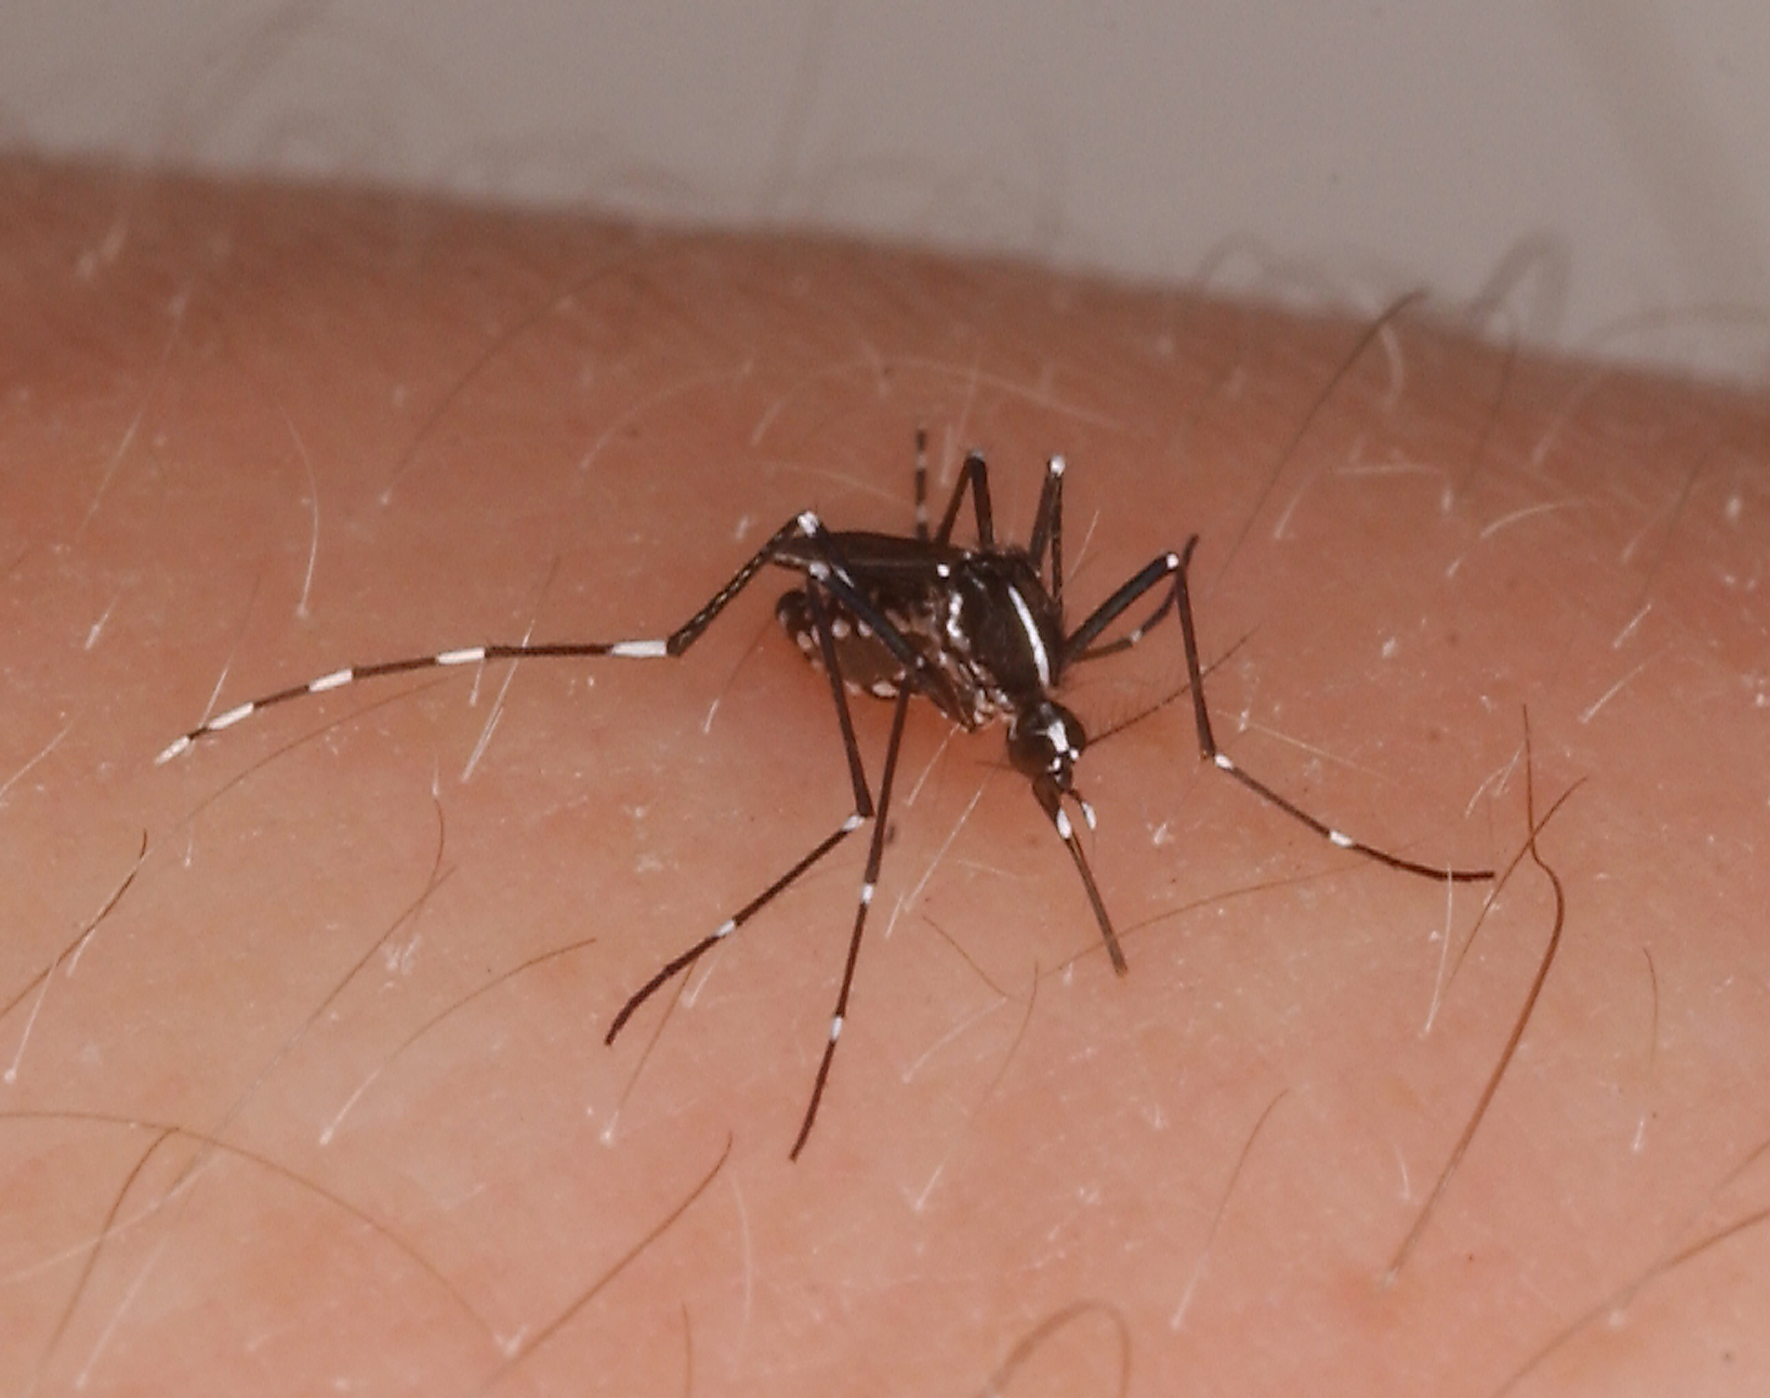

Direct Development
8h L: 16h D
LD photoperiod (Non-Diapause-inducing)
3x
RNA extraction
Sequencing
16h L: 8h D
RNA extraction
SD photoperiod (Diapause-inducing)
3x
Sequencing
Diapause
Individual reads
De novo assembly
Contig
Annotation via blastx
Annotated Contig
Map reads to assembly, calculate differential expression
Annotated Contig
Diapause reads
Individual reads
Non-diapause reads

