Slide 1
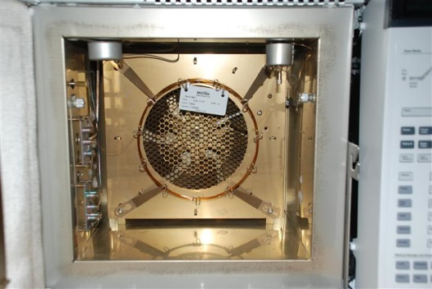
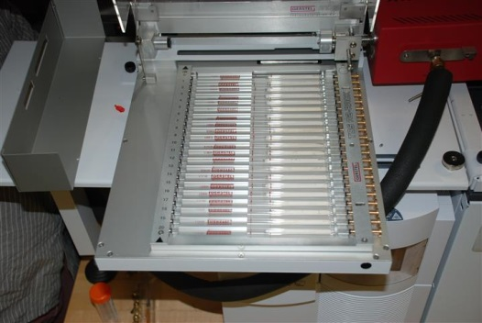
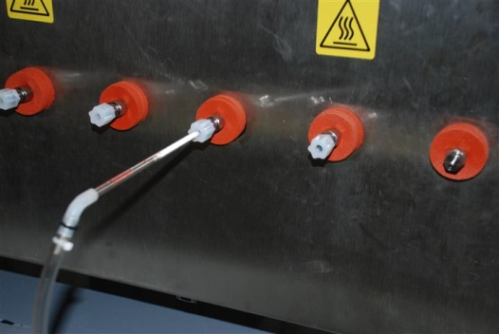
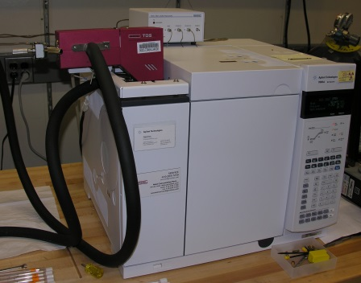
(P1)
(P2)
(P3)
(P4)
(P5)
(P6)
Final Schematic Text: (Intro) In this procedure, trace explosive vapors are quantitated using programmed temperature desorption Gas Chromatography with an Electron Capture Detector. (P1) First, the instrument is prepared for analysis. (P2) Solution standards are prepared and deposited onto absorbent filled sample tubes. (P3) The sample tubes are run on the TDS-GC-ECD to establish a calibration curve for quantitation. (P4) Trace explosive vapor samples are collected on sample tubes. (P5) The unknown explosive vapor samples are analyzed with the TDS-GC-ECD instrumentation. (P6) The calibration curve is used to quantitate the trace explosive vapor samples.

