Slide 1
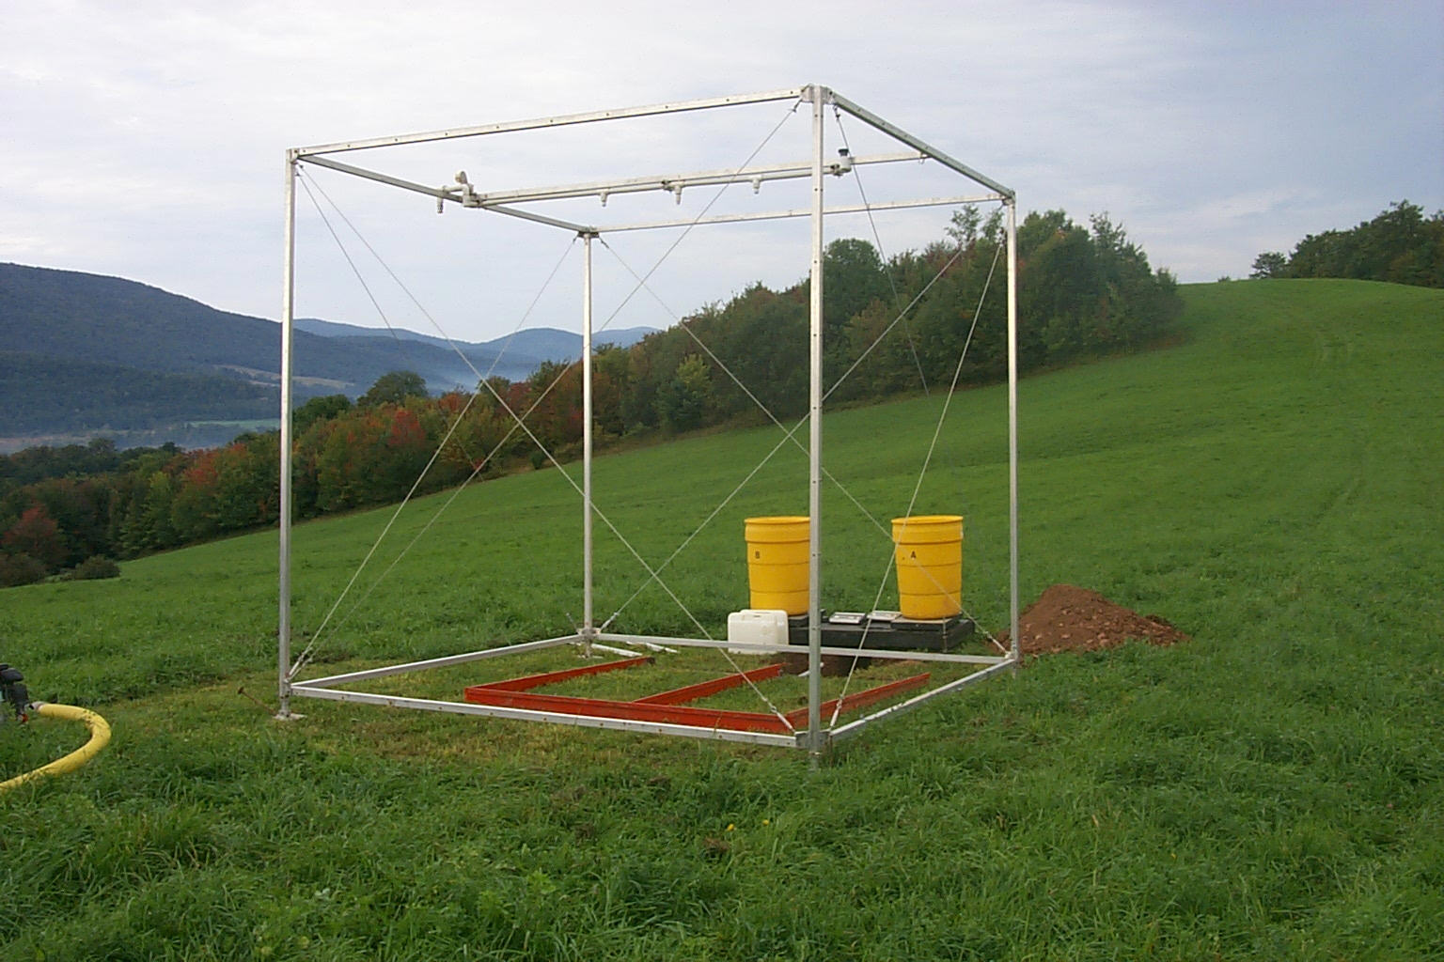

Slide 3
Empty Soil Box

Slide 4

Packed Soil Box

Slide 5
Rainfall Simulator Frame

Slide 6

Step 1: Pack soil boxes to uniform density.
NOTE TO EDITOR: Soil Image located at: https://www.google.com/search?q=clip+art+free+soil+pile&rlz=2C2FLDB_enUS0537US0537&tbm=isch&tbo=u&source=univ&sa=X&ei=dafFUt7dB8jIkAewv4DoAg&ved=0CCwQsAQ&biw=1440&bih=798

Slide 7
Step 2: Adjust rainfall simulator controls to achieve the approximate pressure and flow rate for the selected nozzle.

Slide 8
Step 3: Calibrate the rainfall simulator to achieve the exact flow rate for the selected nozzle and a uniform distribution of raindrops across the target area.

Slide 9


Step 4: Position the soil boxes in the target area on a platform adjusted to a uniform slope.

Slide 10
Final Step: Conduct a rainfall simulation and collect soil runoff for analysis.

Slide 11
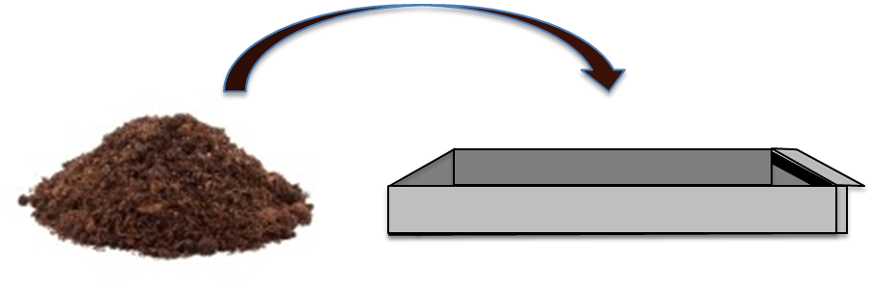
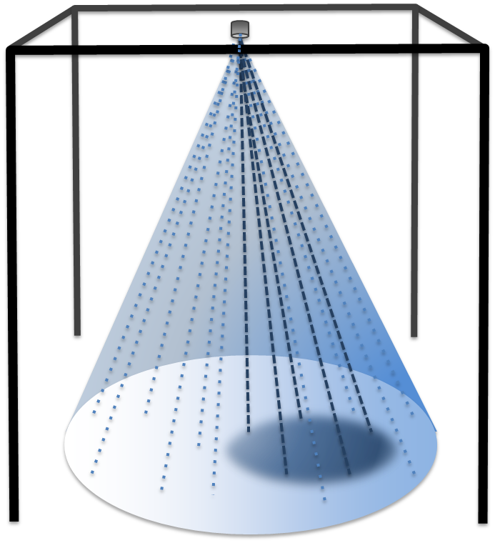
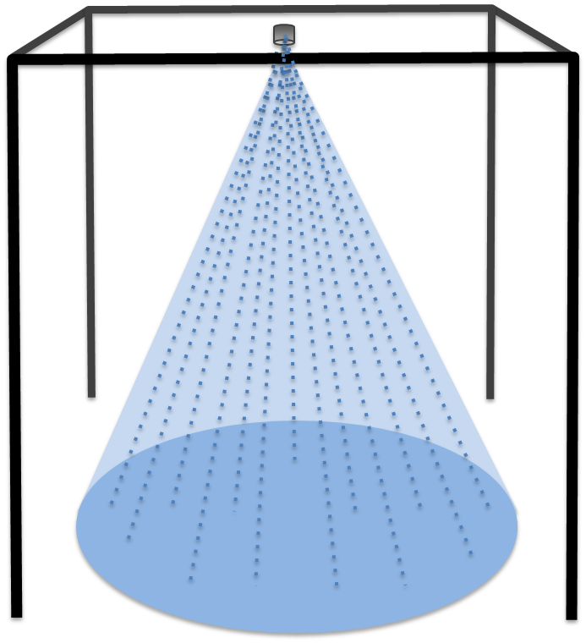
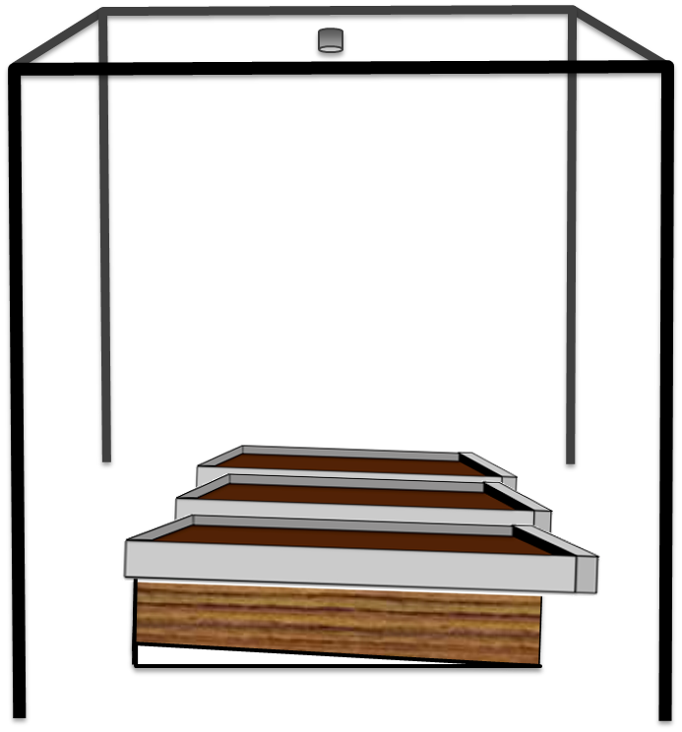
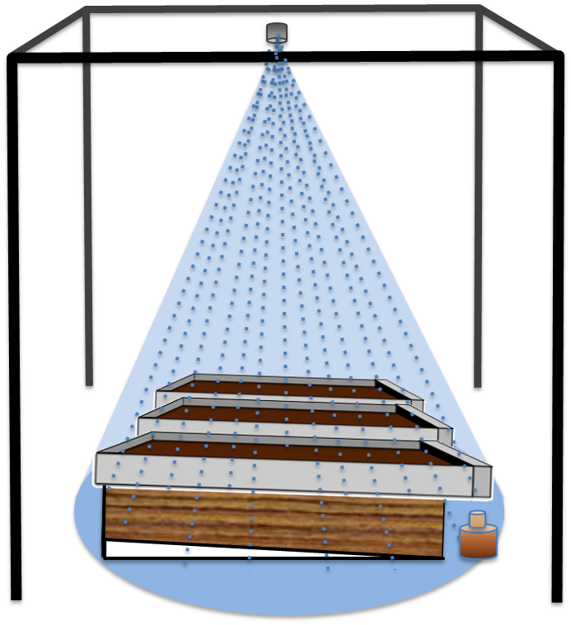
Schematic Overview
(P1)
(P2)
(P3)
(P4)
(P5)

