Slide 1
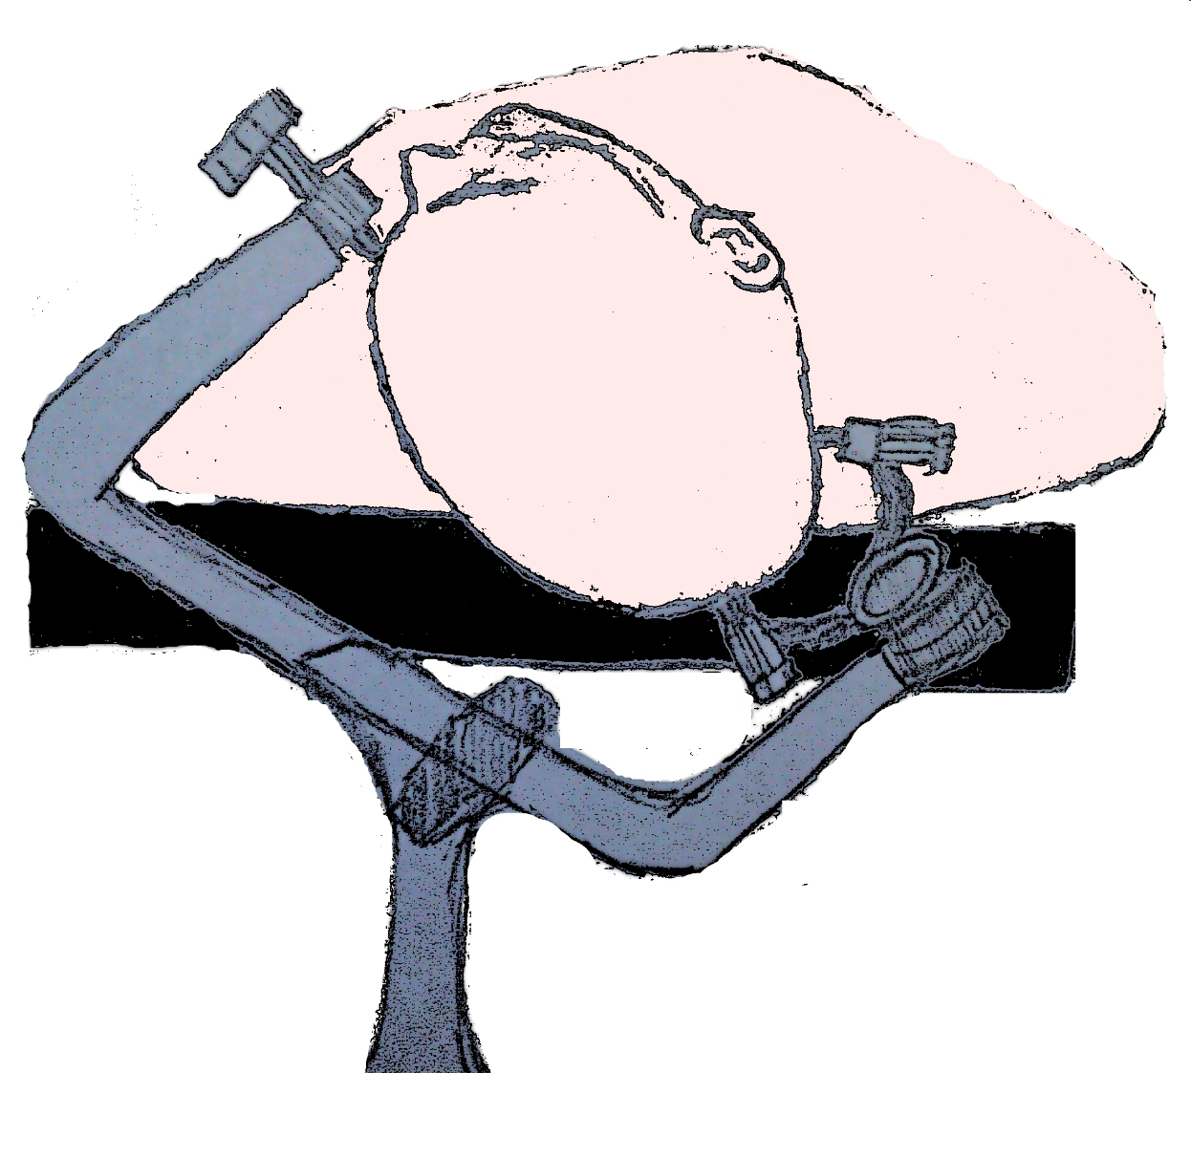
P1

Slide 2

P2

Slide 3

P3

Slide 4

P4

Slide 5
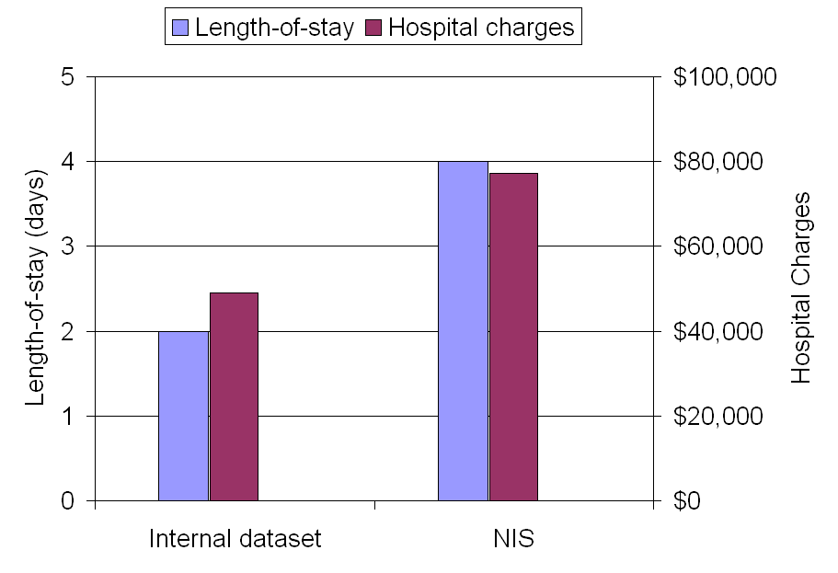
P5

