Slide 1
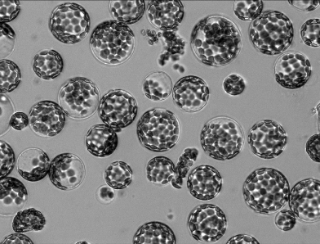
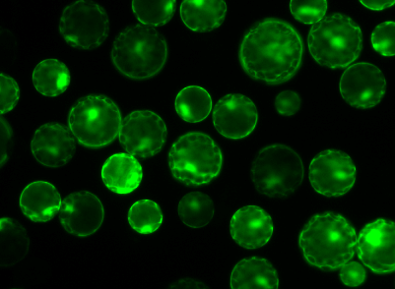
A
B
Figure 7
Shatil-Cohen et al., 2014

