Slide 1
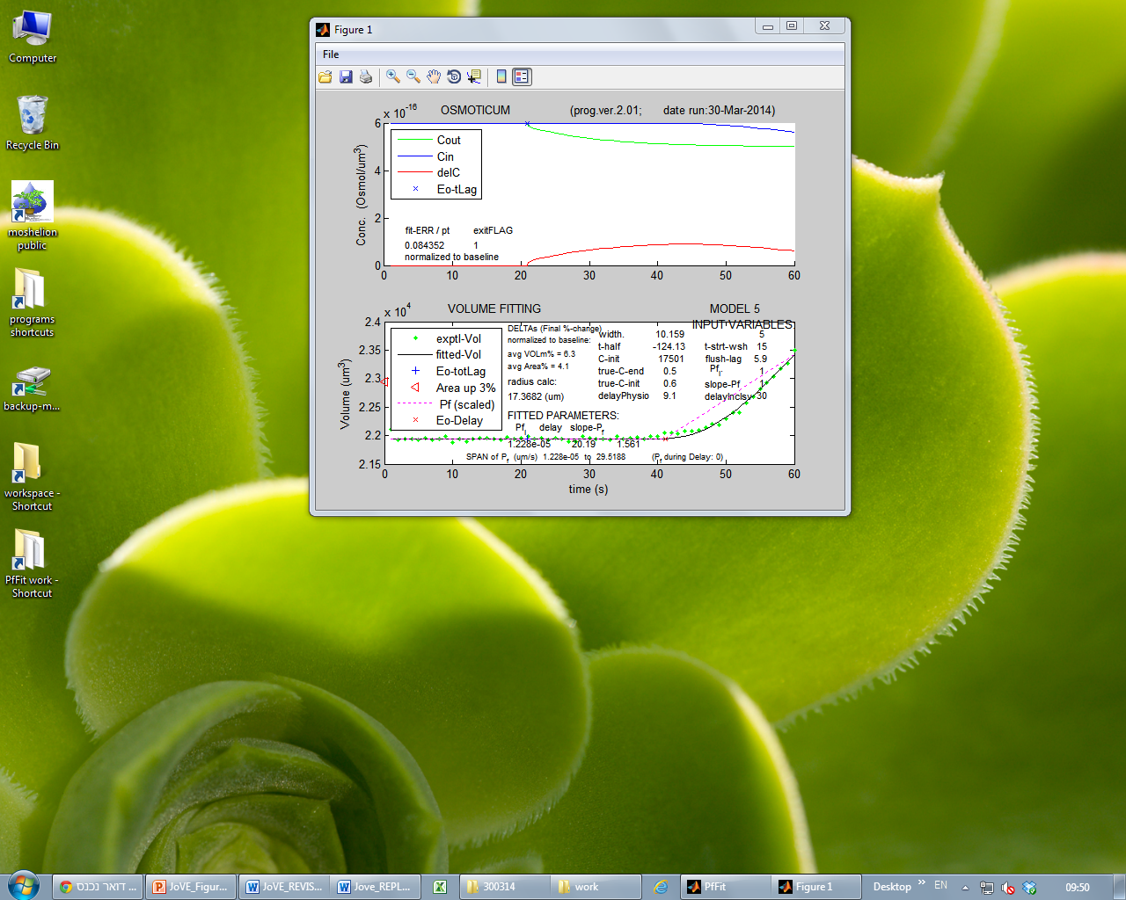
A
B
Figure 6
Shatil-Cohen et al., 2014

