Slide 1
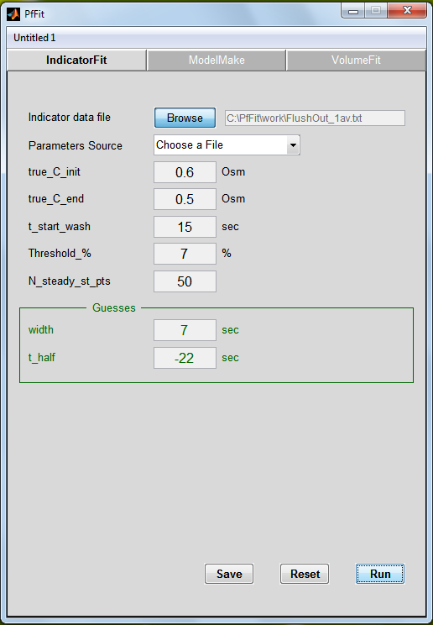
A
B
Figure 3
Shatil-Cohen et al., 2014

