Slide 1
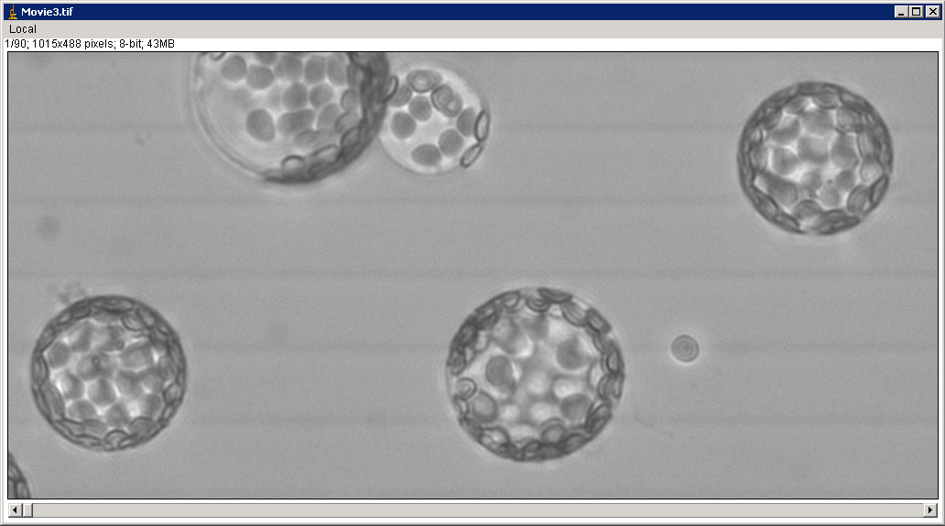
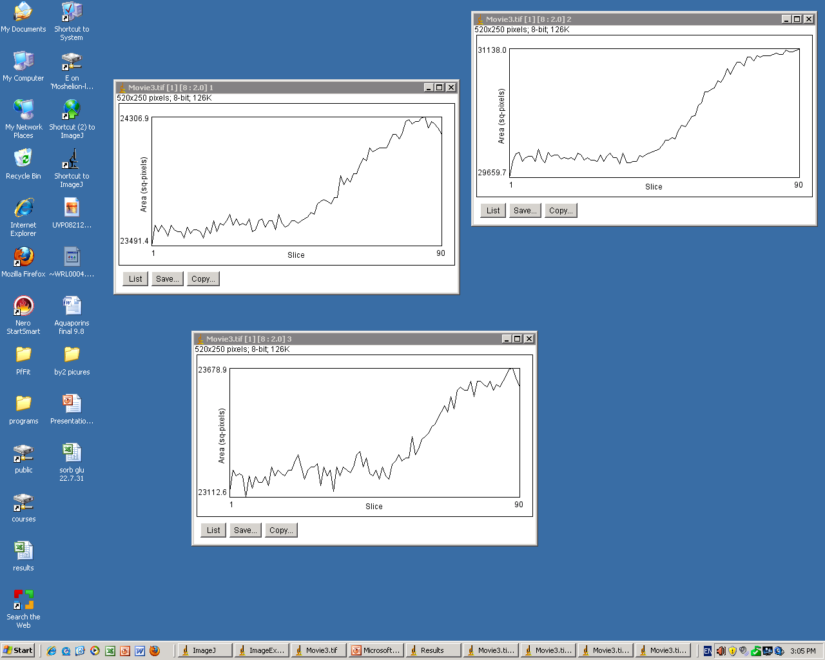
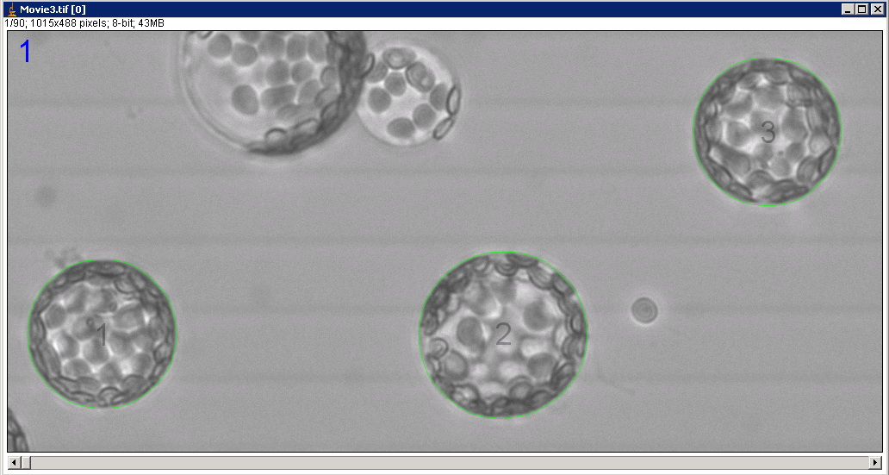
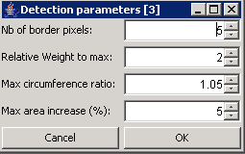
A
B
a
1
2
AREA (Number of square pixels)
b
3
1
2
3
c
3
‘TIME’ (units of image number)
C
1
2
Figure 2
Shatil-Cohen et al., 2014

