Slide 1
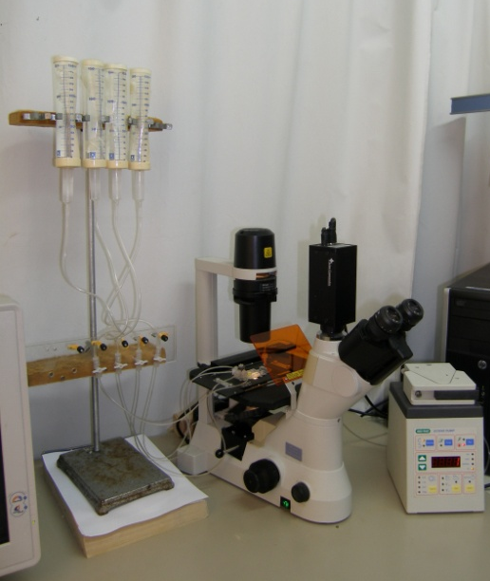
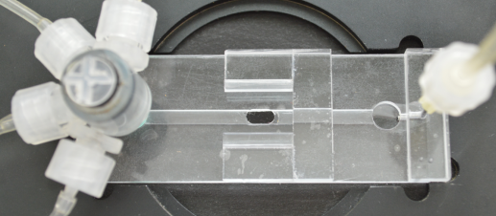
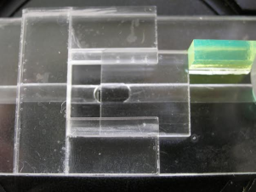
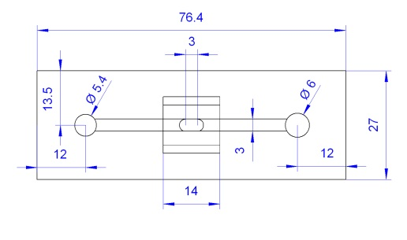
A
IS
HS
Cols
T
Cm
V
P
D
B
Chr
In
Out
C
E
c
c
d
8.5
13.4
13
14
c
d
4.3
d
c
2.3
2
2
b
a
b
a
Figure 1
Shatil-Cohen et al., 2014

