Slide 1

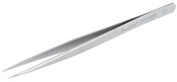
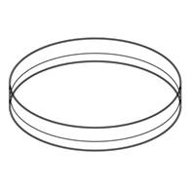
Protoplast isolation

Slide 2
28°C
20 min

Slide 4

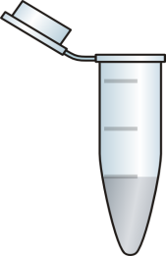
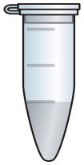

Slide 5
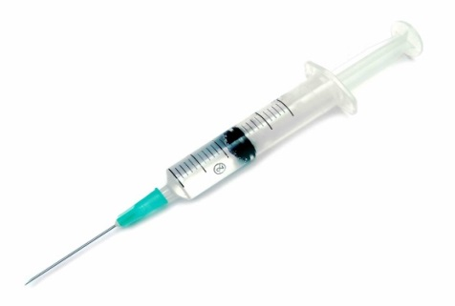
Chamber preparation
“Glue”: poly-L-Lysine / protamine sulfate
Isotonic sol.

Slide 6


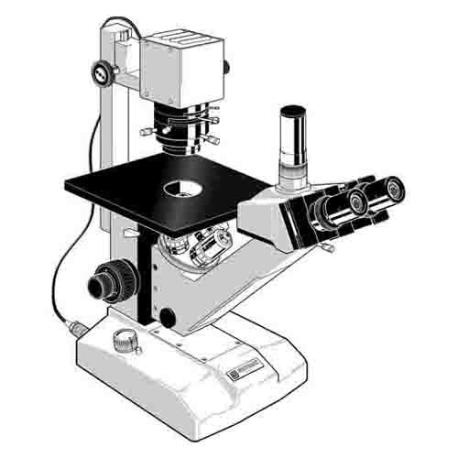
Hypotonic sol.
Isotonic sol.
Switching valves
Camera
PUMP
1 ml/min

Slide 7
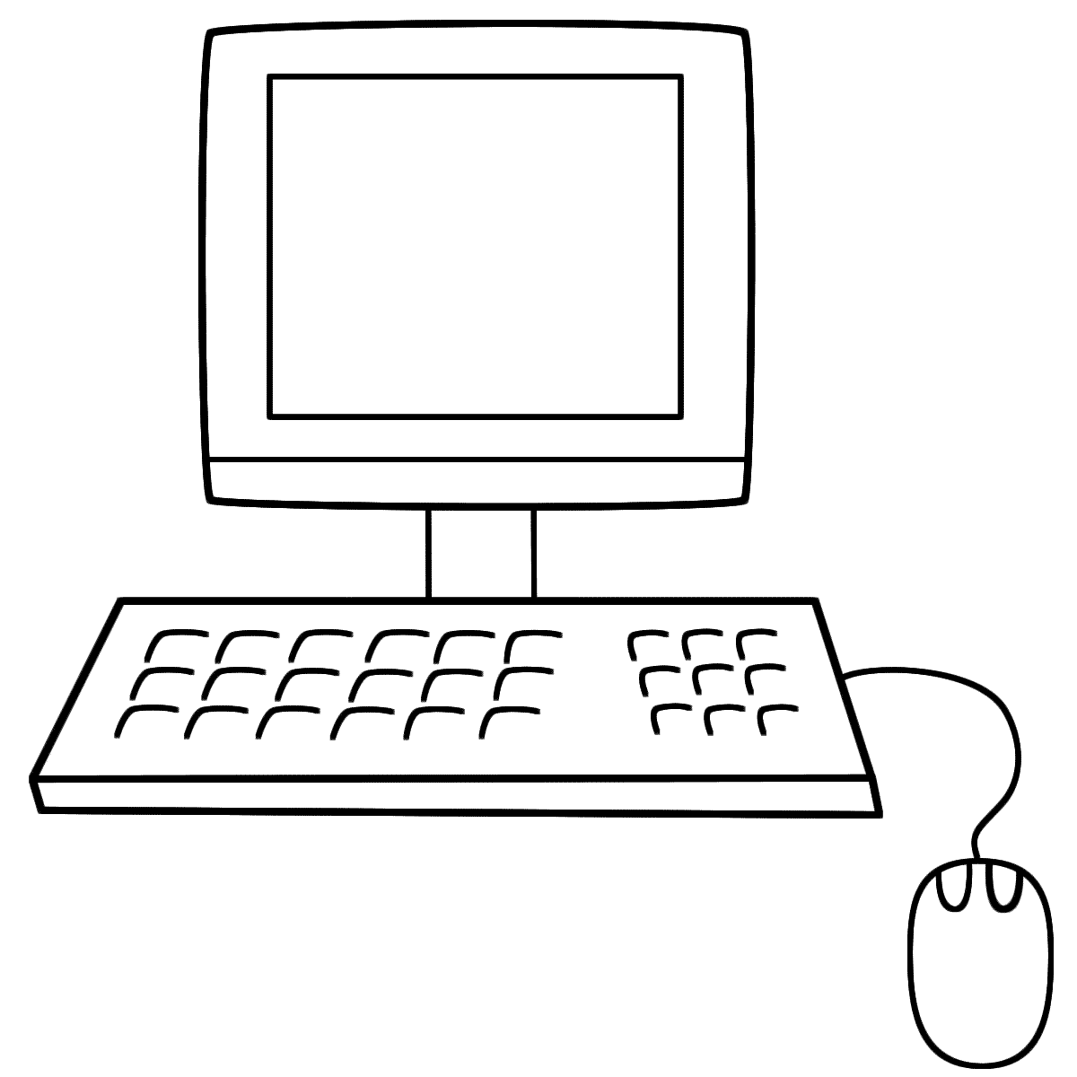
Swelling assay
Switch from isotonic to hypotonic solution
Analysis
15 sec
45 sec
Swelling time course
ImageJ
Image Explorer
and
Protoplast
analyzer
110
105
Relative volume (%)
100
0
15
30
45
60
Time (s)
ImageJ
Transmittance time course
Density analysis
Indicator Dye transmittance
0
15
30
45
60
Time (s)

Slide 8
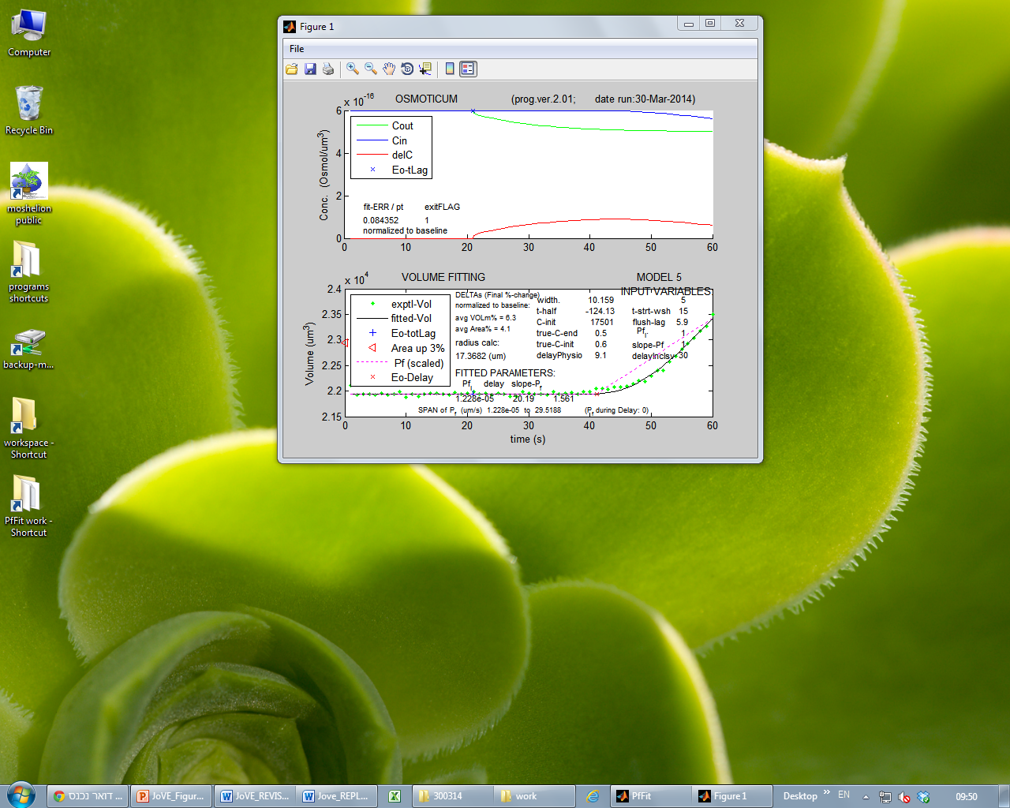
Osmolarity time course
PfFit
program
18
12
P_{f} (µm/s)
6
0
Control
Treatment

Slide 9
PfFit
program
The SWELLING time course - FITTED
18
12
P_{f} (µm/s)
6
0
Control
Treatment

