Slide 1
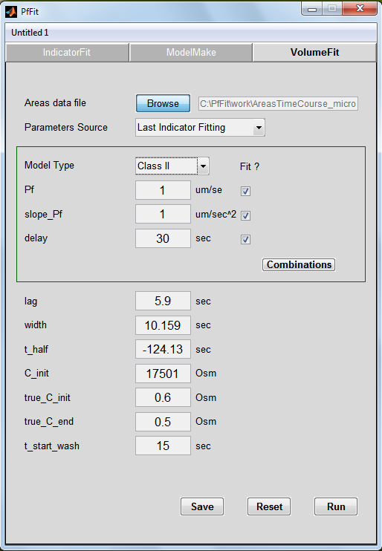
A
B
C
D
Figure 5
(Continued on next page)
Shatil-Cohen et al., 2014

Slide 2
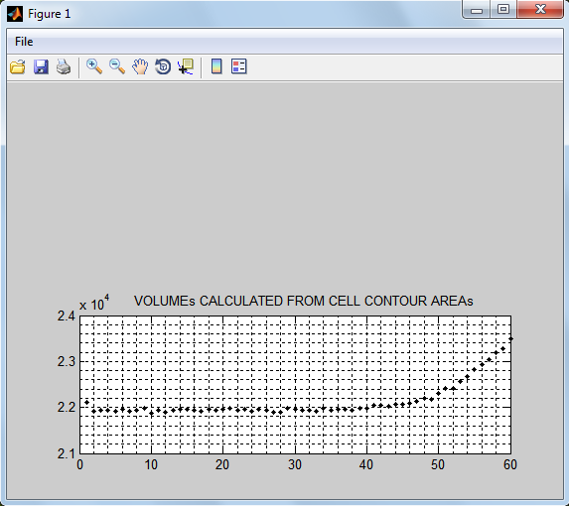
E
Figure 5
(Continued from prev. page)
Shatil-Cohen et al., 2014

