Slide 1
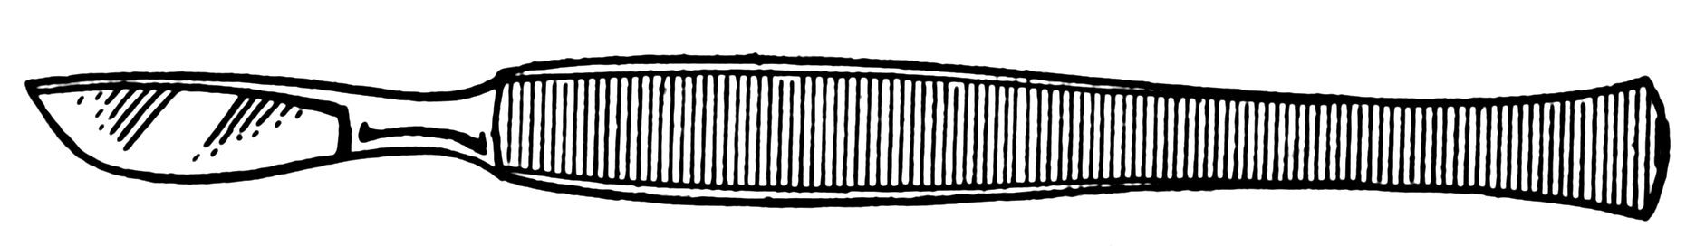

Slide 4
zone of junction

Slide 9
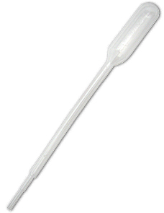
1X PBS

Slide 10
1X PBS

Slide 11
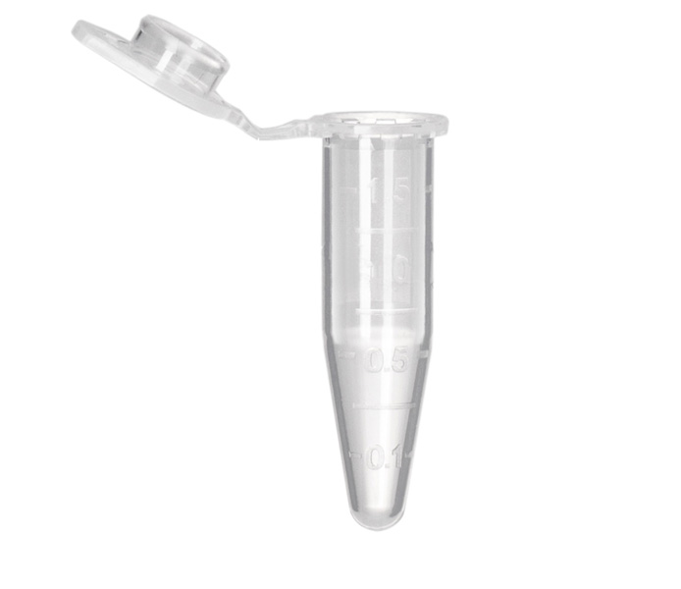
1X PBS
4% PFA
-80°C

Slide 12
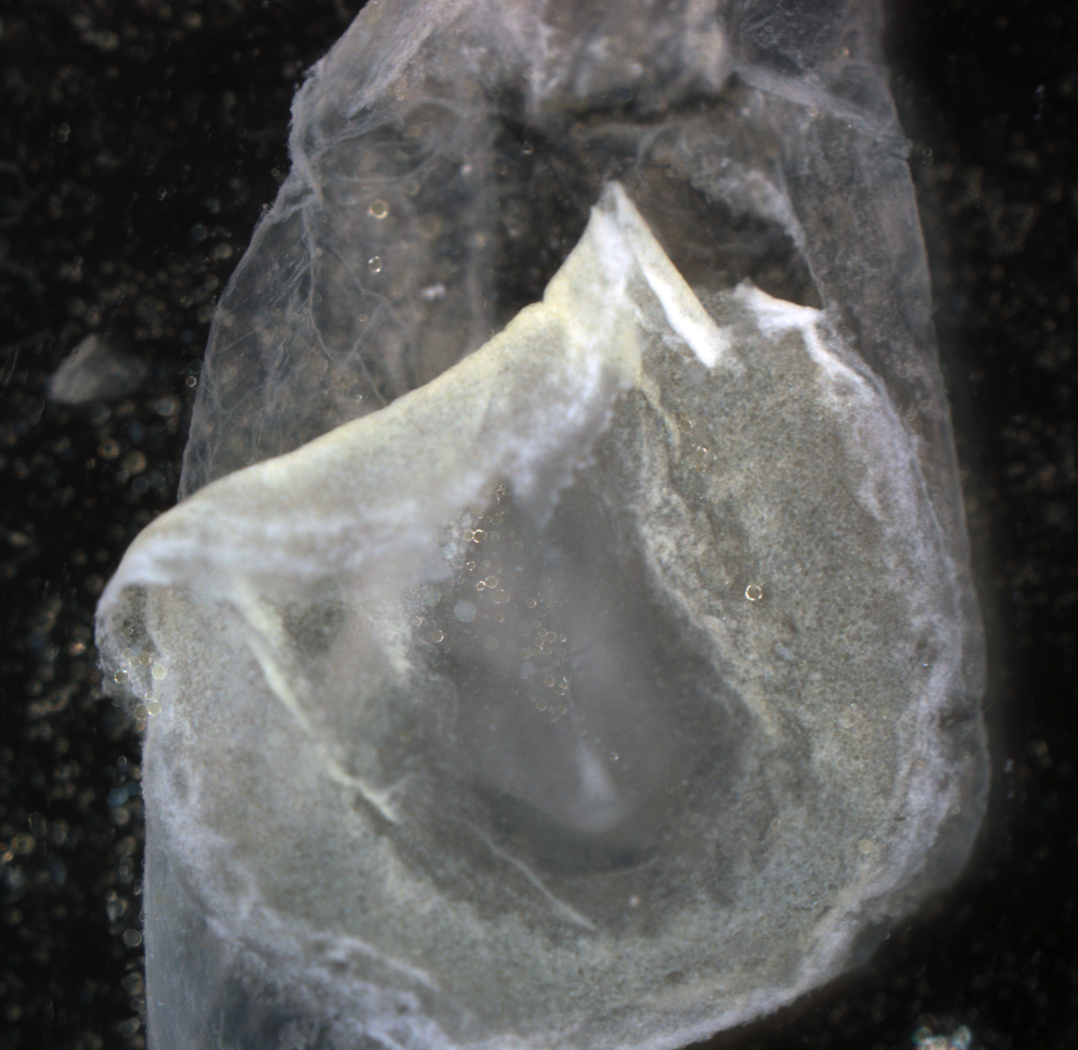
1X PBS
4% PFA

Slide 13
1X PBS
4% PFA
zone of junction
vitelline membrane

Slide 14
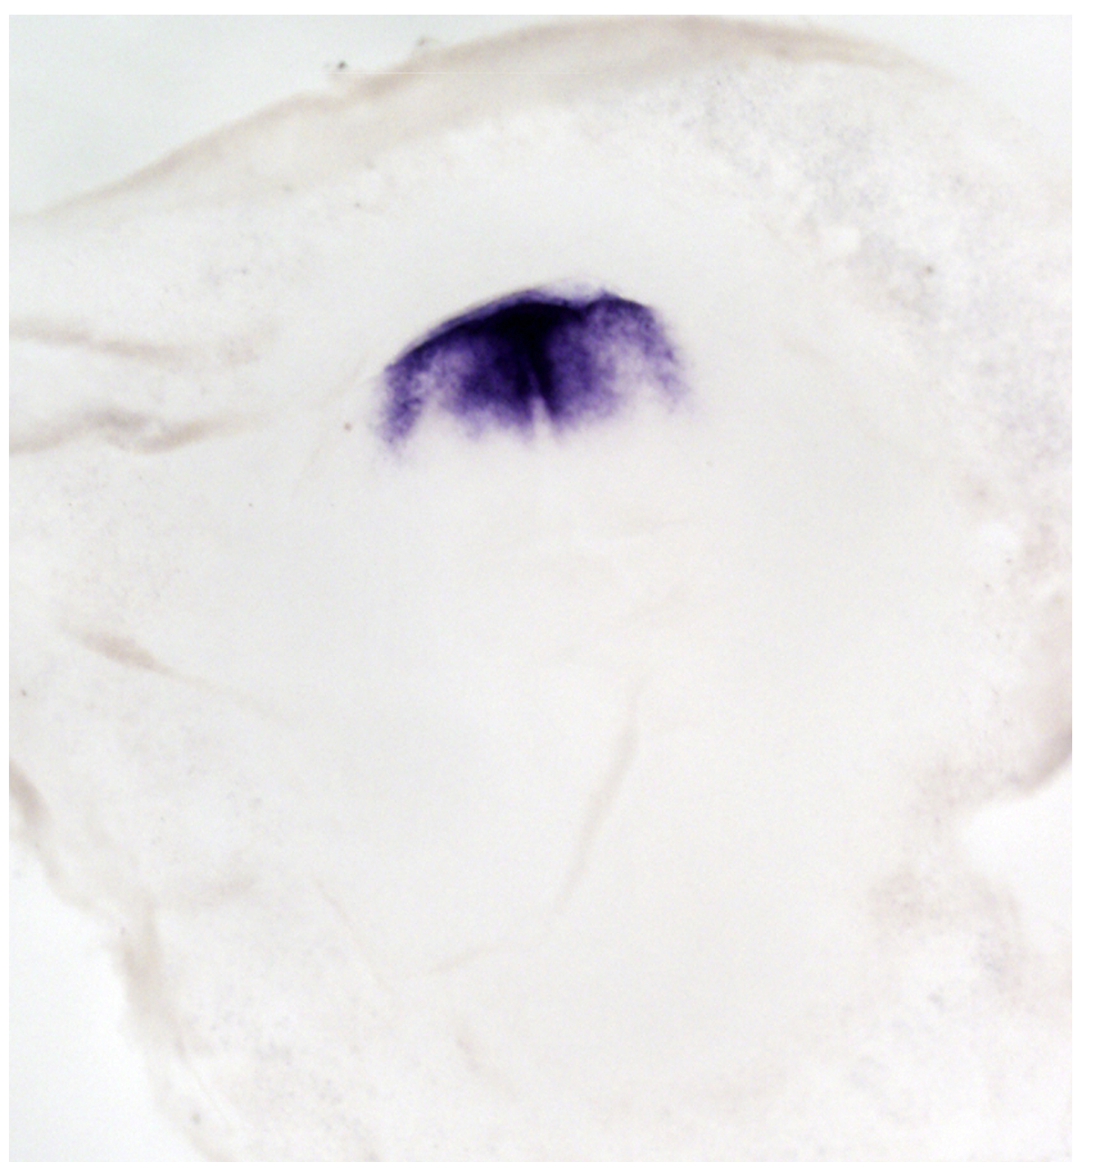
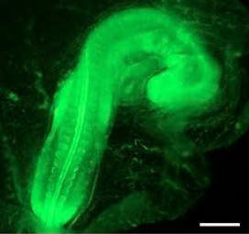
In Situ Hybridization or EdU Assay

