Slide 1



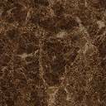

(P1)
(P3)
(P2)
1 yr later
(P4)
Resistant
(P5)
Susceptible

