Slide 1
Before-after NoN- same plane- same settings
Fig. 3A
Raw Data
Deconvolved
Fig. 3B

Slide 2
Before-after NoN- same plane- same settings
Fig. 3A
Raw Data
Fig. 3B
Deconvolved
2D- slice view
3D-Volume View

Slide 3
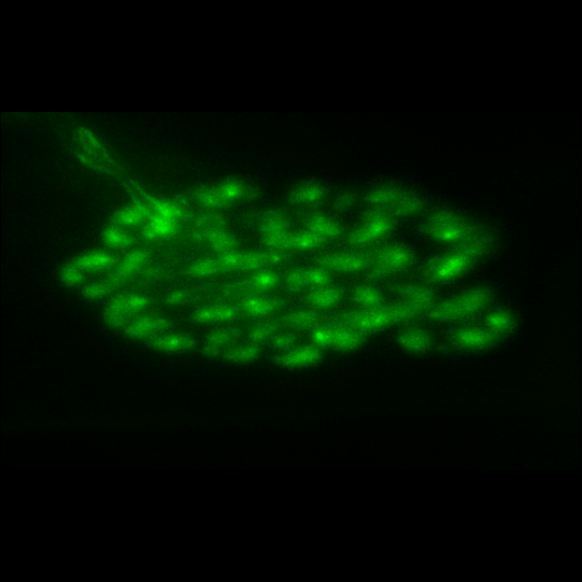
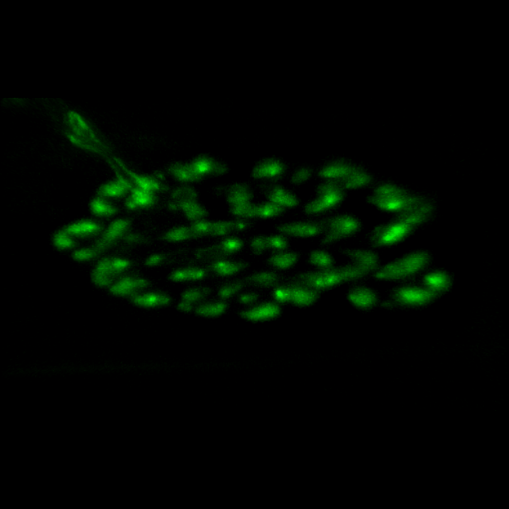
Final outputs- as 3D Volume views- rotates on Y axis
Fig. 3A
Fig. 3B
Raw Data
Deconvolved

Slide 4
Before-after NoN- same plane- same settings
Fig. 3C
Raw Data
Deconvolved
Fig. 3D

Slide 5
Before-after NoN- same plane- same settings
Fig. 3C
Raw Data
Fig. 3D
Deconvolved
2D- slice view
3D-Volume View

Slide 6
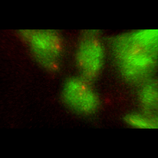
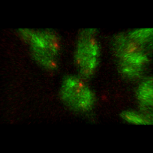
Final outputs- as 3D Volume views- rotates on Y axis
Fig. 3C
Fig. 3D
Raw Data
Deconvolved

