Slide 1
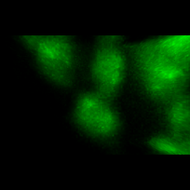
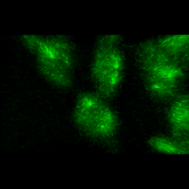
Raw Data
Deconvolved
Notes:
3D rotations- triggered

