Slide 1
08-02-13
Ilona- test data processing
Slidebook editing- screenshots-
Step by meticulous step
Annotated by RS
Raw data- Fig 2 dataset (4D)
Aka #71
TIFF exports

Slide 2
Open Slidebook “slide”- All image captures displayed.
Note 4D image dimensions (X, Y, Z, T)

Slide 3
Open individual image to display.
Not an ideal display- didn’t pick an optimal Z plane

Slide 4
Deconvolve using No Neighbors algorithm

Slide 5
Deconvolve using No Neighbors algorithm-
As a rule, we stick to defaults

Slide 6
Select All images with same channels-
Useful for processing in batch- saves time ( but RAM heavy)

Slide 8
New “slide” created with NoN images

Slide 9
Open deconvolved image

Slide 10
Comparison of before-after NoN deconvolution

Slide 12
cropping

Slide 13
CtrlB- select in all planes – essential for 3D, 4D images

Slide 15
New file automatically gets sent to bottom of open slide.

Slide 16
Cropped file saved- X, Y dimensions are changed (hidden here)
cropped

Slide 18
Creating 4D viewing options- 4D Volume view

Slide 19
Change default displays to more useful ones

Slide 20
MIP (maximum image projection) view- no grid displayed

Slide 22
Re-adjust contrast to look better

Slide 23
Display view can be rotated systematically or by hand

Slide 24
Export setup- in this case, a movie

Slide 25
Export for timelapse only (not very useful – easier to do with “export series movie”)

Slide 26
Selection for QTVR view (fully rotatable in 4D-
Creates a HUGE file)

Slide 27
Selection for “4D volume view” (Y axis default)
(plays timelaspe, rotates 15 deg, re-plays, etc )
-also pretty large file

Slide 28
Can be saved as QuickTime(.mov) or media player compatible (.AVI)
-File size will be large for lossless

Slide 29
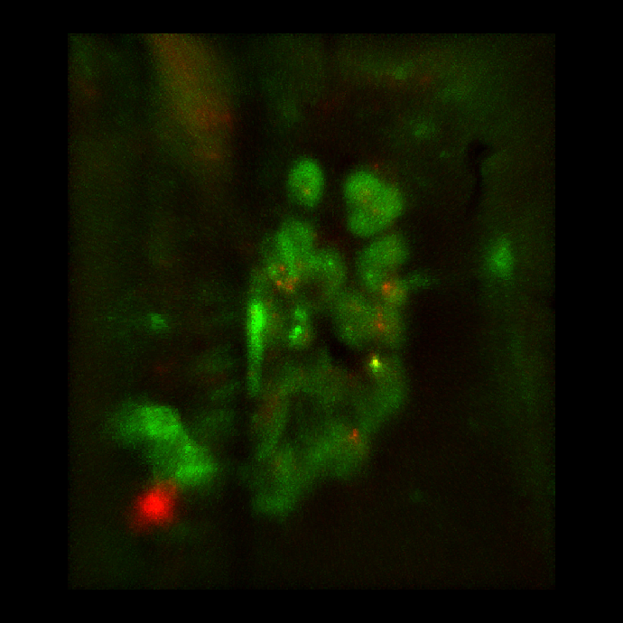
Final export- movie (2D timelapse only)- NOT drift corrected

Slide 31
Saving edited slide

Slide 32
Re-saving edited slide- new file designation sometimes added automatically

