Slide 1
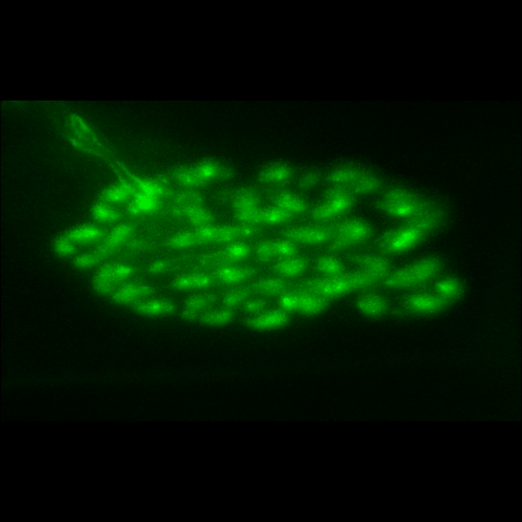
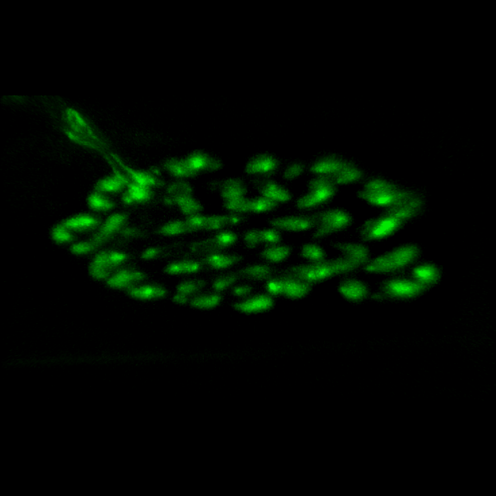
Fig. 3A
Fig. 3B
Raw Data
Deconvolved

Slide 2
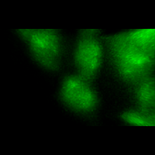
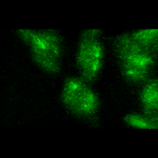
Fig. 3C
Fig. 3D
Raw Data
Deconvolved

