Slide 1
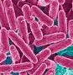
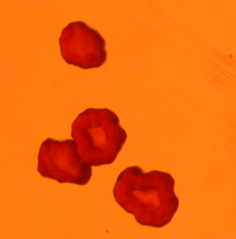
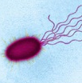
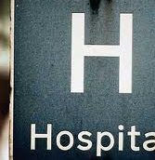
Different growth conditions or strains with different cyclic-di-GMP levels were also used
Stationary phase (OD₆₀₀ = 2)
PAO1 high [c-di-GMP]
(small colony variant)
Stationary phase
Death phase
PAO1 low [c-di-GMP])
Number of cells
Log phase
Early log phase (OD₆₀₀ = 0.5)
Lag phase
Clinical strains
Time

Slide 2
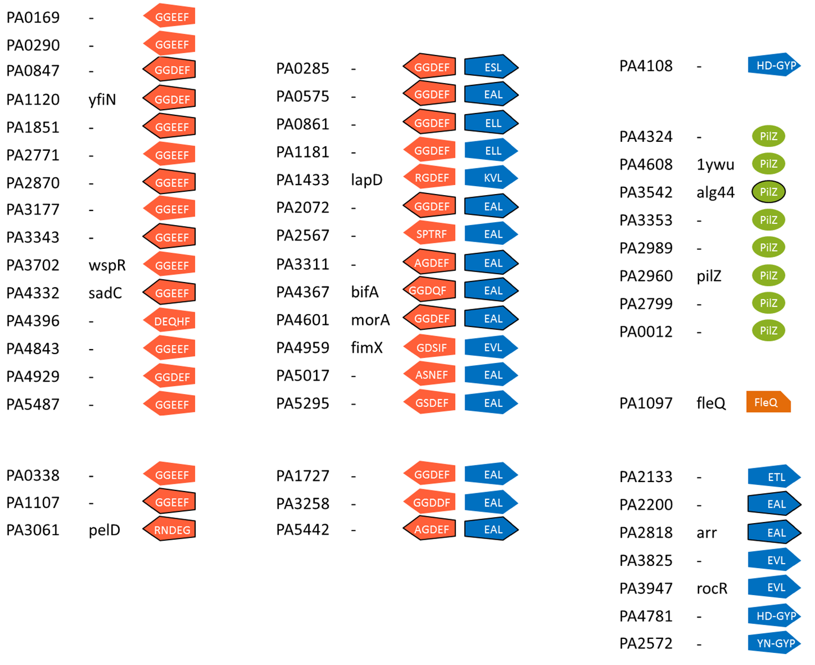
CCMS identified 74% (38/51) of the known or predicted components of the c-di-GMP network
Captured
74%
26%
Never captured
Circled: membrane protein
GGEEF
Protein with a conserved of degenerated GGDEF domain
EAL
Protein with a conserved of degenerated EAL or HD-GYP domain
GGDEF
EAL
Composite GGDEF-EAL protein
PilZ
protein with a conserved of degenerated PilZ domain

