Slide 1
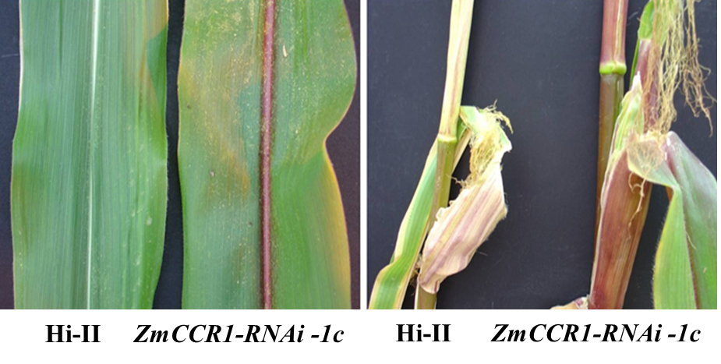
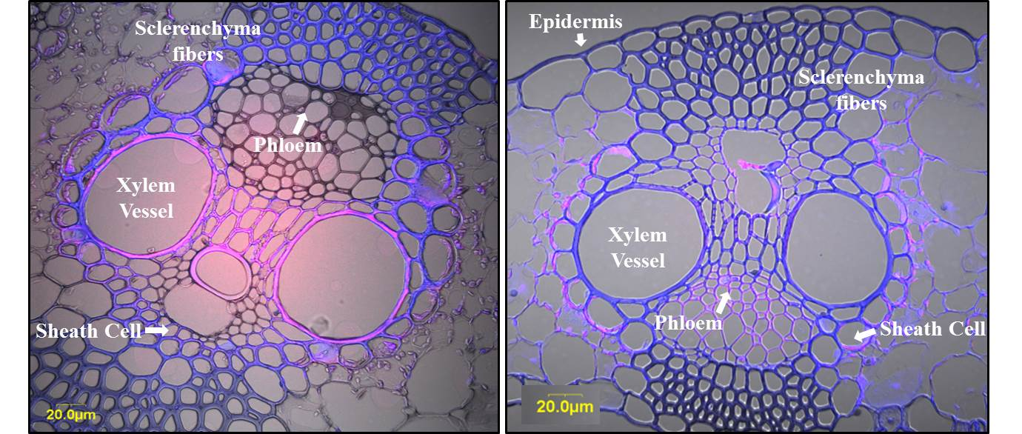
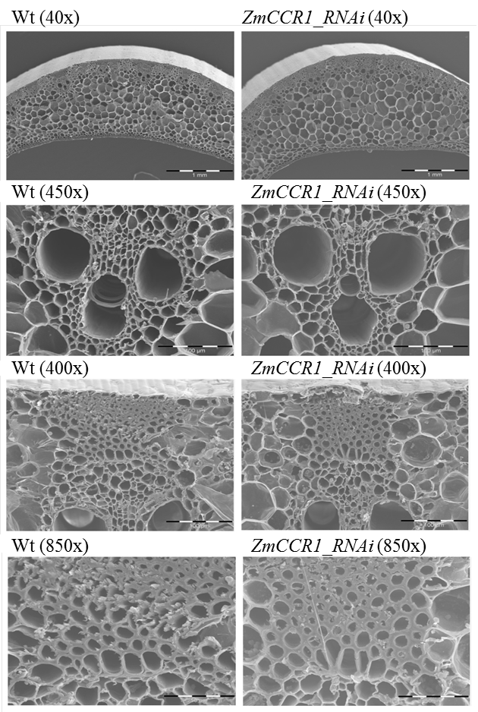
A.
Wild-type ZmCCR1_RNAi
Wild-type ZmCCR1_RNAi
B.
C.
Sclerenchyma fibers
Sclerenchyma fibers

Slide 2
