Slide 1
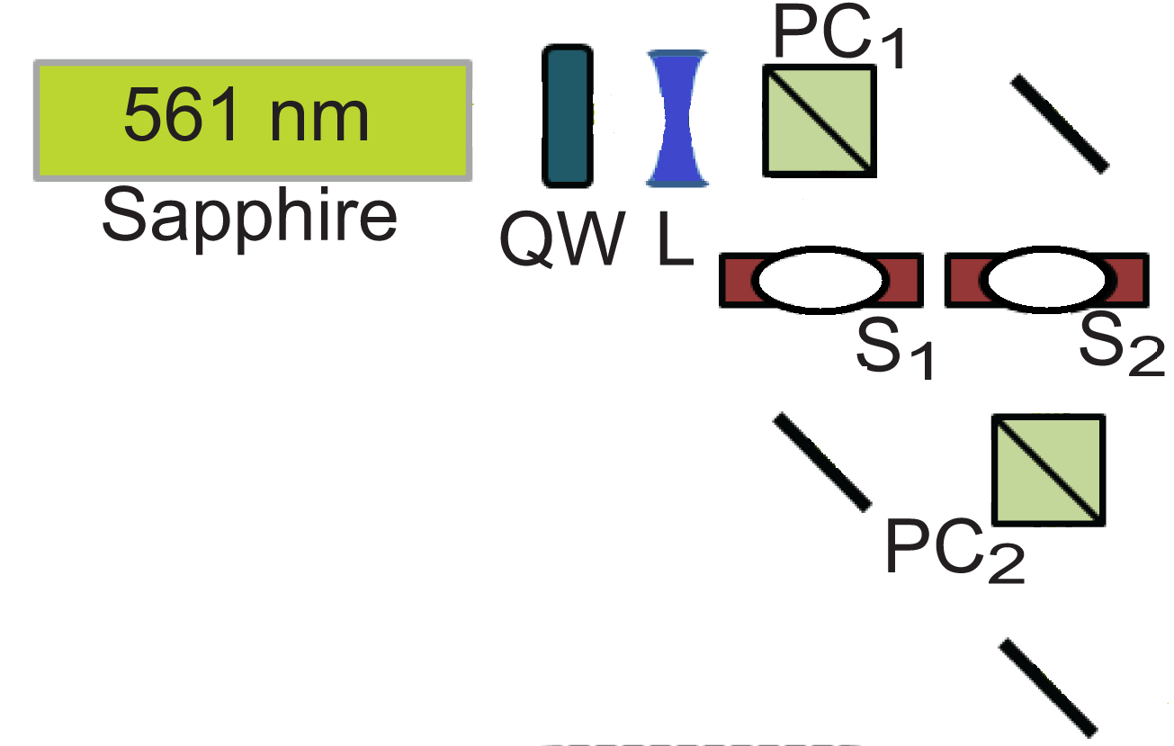

Step One

Slide 2
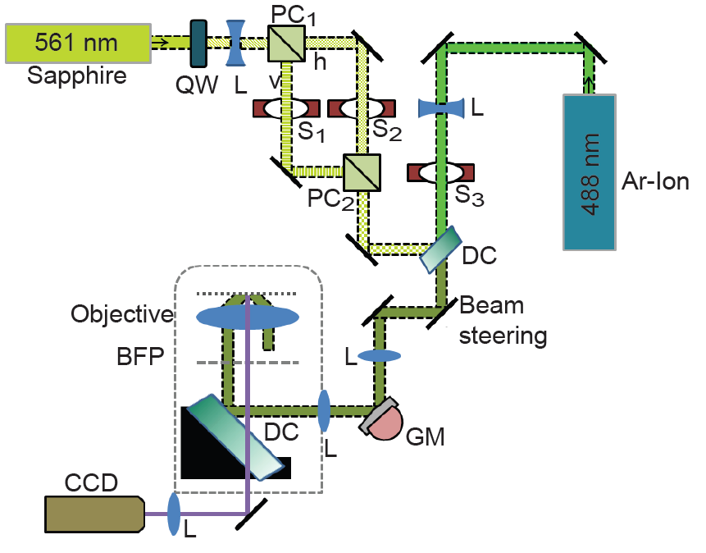
Step Two

Slide 3
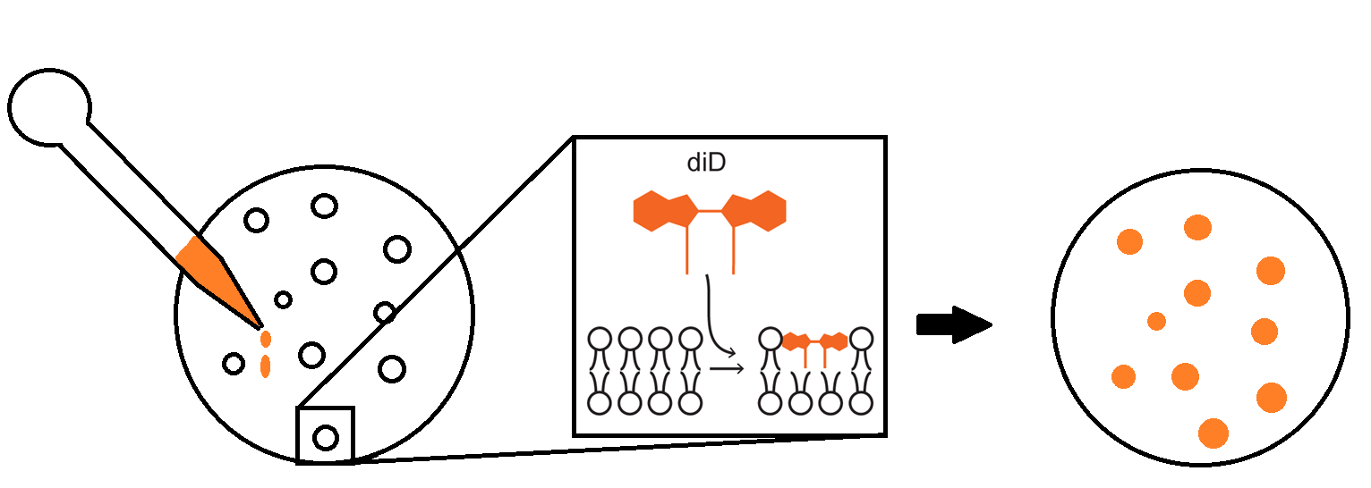
Step three

Slide 4



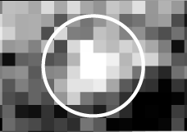

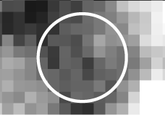
Image Acquisition
Before Depolarization
After Depolarization
Arg ion
100 nm
P-pol
S-pol
Step Four

