Slide 1
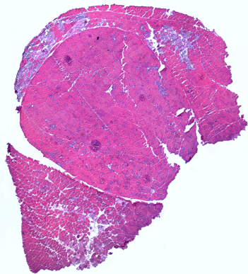
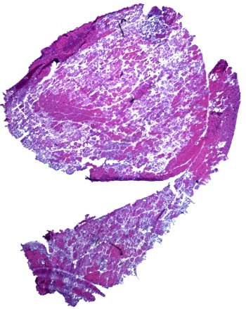
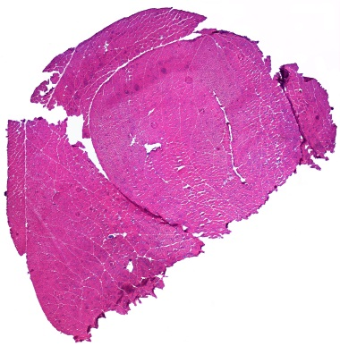
Figure 4
A
Two limb hanging test after treadmill exercise
Wt
Longest hanging time (sec)
Mdx
Age (weeks)
B
*
Creatine Kinase level (U/L)
Before exercise
After exercise
C
D
E

