Slide 1
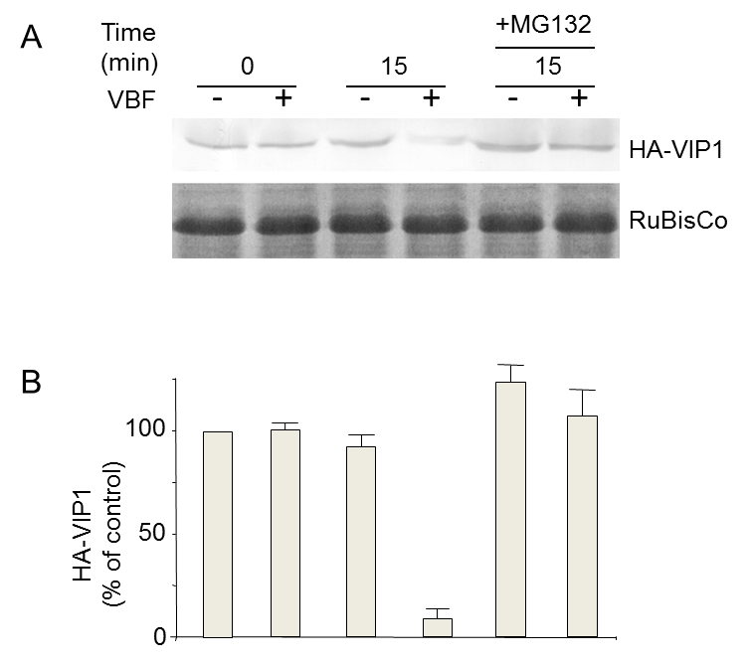
Editors, please highlight the fourth HA-VIP1 band as “VIP1 amounts were reduced to a significant degree when coexpressed with VBF” is narrated.

Slide 2
    Then highlight HA-VIP1 bands 1 through 3 as “but remained relatively stable in the absence of VBF coexpression” is narrated.

Slide 3
    Editors, please highlight the last HA-VIP1 band as this point is narrated.

Slide 4
    Editors, please highlight the fourth bar on the bottom graph as “Quantification of these results demonstrated almost complete inhibition of VIP1 by VBF” is narrated. Then, highlight the last bar as “which was blocked by MG132” is narrated. Finally, continue to highlight last bar and also highlight the fifth bar as the last sentence is narrated.

