Slide 1
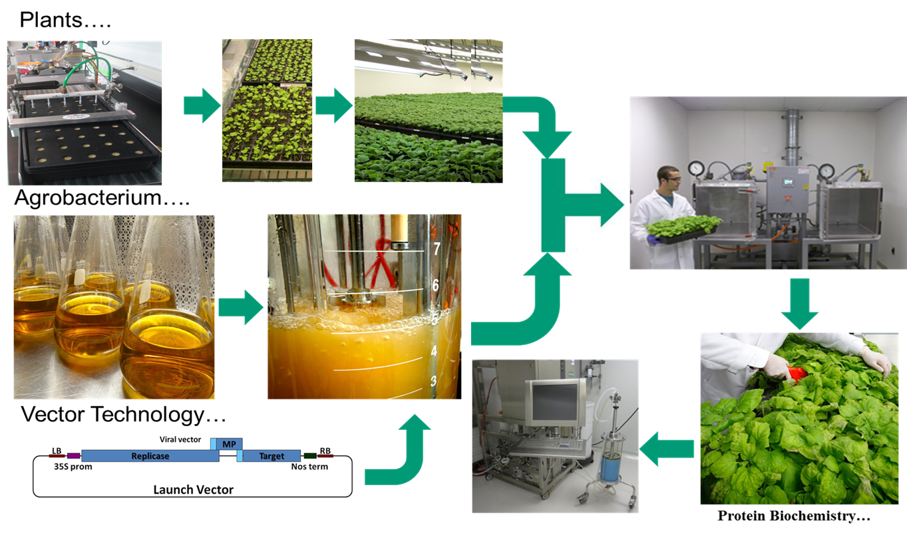

Slide 2
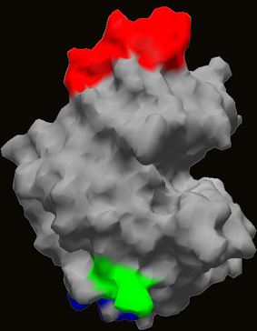
Mechanism of Action of the Launch Vector
35S
Replicase
Movement
Target
Nos3’
LB
RB
Launch Vector
Excision
35S
ssDNA
Nos3'
Transcription
Subgenomic Transcription and Translation
Self-replicating RNA
Replication
Protein Synthesis

