Slide 1
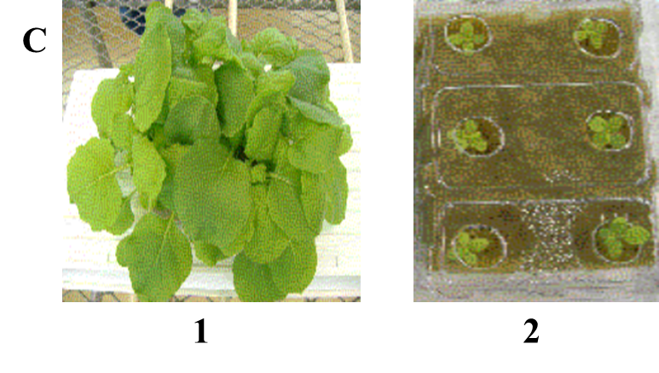


Figure 1
A
B
GFP Std
Media dilution
MWM
MMA-1
YEB/5
MMA-2
YEB/10
10 ng
AB/5
20 ng
AB/10
LB/5
5 ng
LB/10
C
GFP Std
4DPI
7DPI
10DPI
MWM
0.1
0.5
0.05
1.0
0.05
1.0
0.5
10 ng
0.05
0.1
20 ng
5 ng
1.0
0.5
0.1

