Slide 1
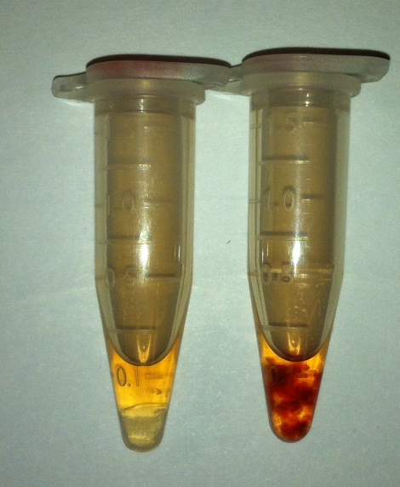
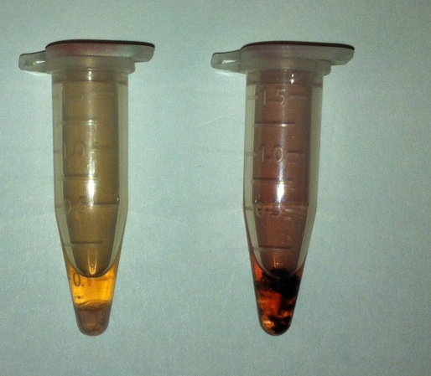
HRP in hydrogel
HRP in DPBS
10 min
30 min
Figure 5B.

