Slide 1
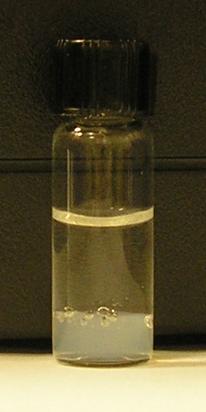
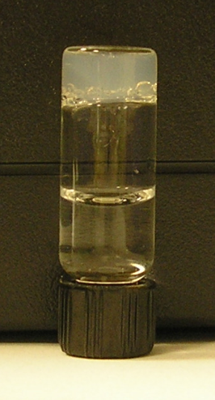
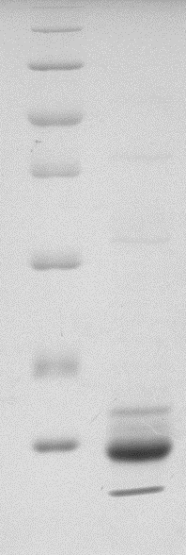
A
B
kDa
116
66
45
J
35
25
Unreacted N
18
*
14
Reacted NpuN
*
C
D
Figure 3.

