Slide 1
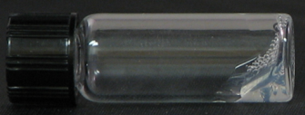
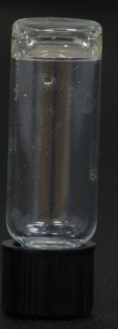
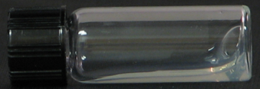
A
B
C: NpuC-S-CutA
N: CutA-NpuN
NpuC
NpuN
NpuC
Mixing
NpuN
NpuC
NpuN
NpuN
NpuC
Individual N & C
(viscous liquid)
C
Hydrogel
J: CutA-S-CutA
kDa
66
45
35
25
18
N C N+C
J
Hydrogel
*
Unreacted N/C
: [(AG)₃PEG]₁₀
: (GGGGS)₂
: CutA
Figure 1.

