Slide 1
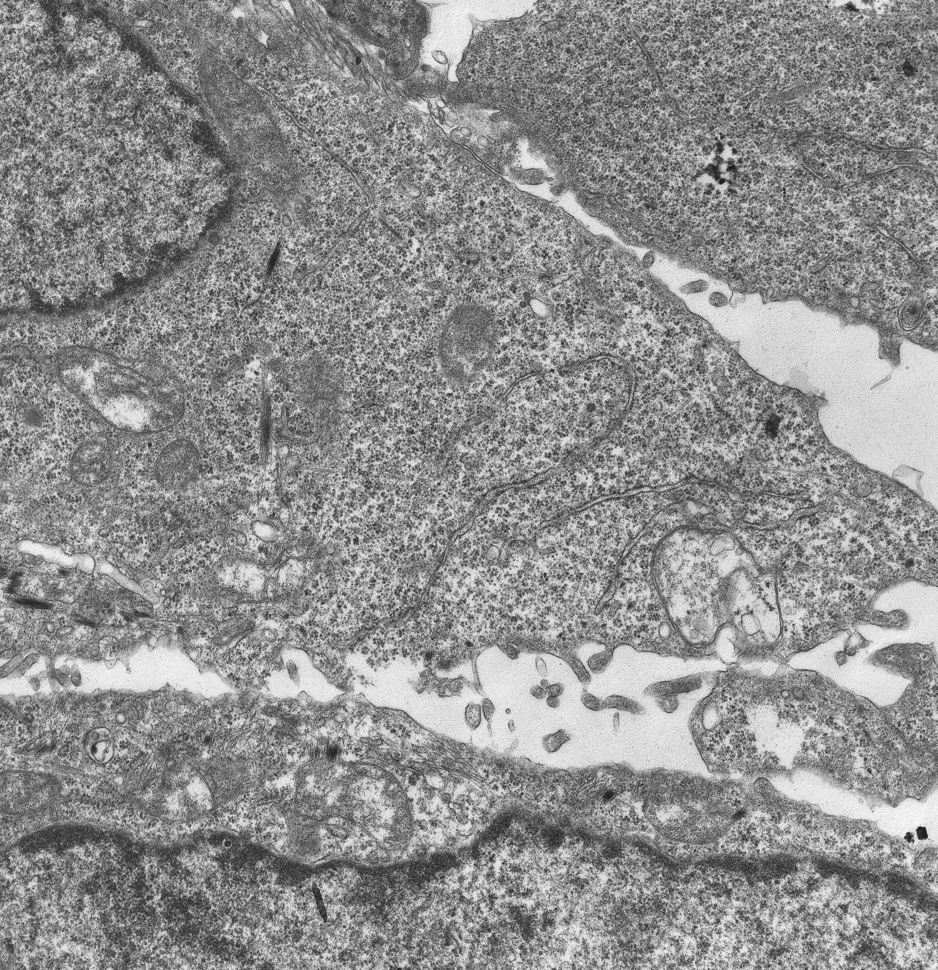
+
+
+
C1
+
+
+
+
+
+
cDNA
Positively-charged
polymers (jetPEI)
24h transfection
C2
37°C, 5% CO₂
C3
63x
Inclusion of cell pellet in epon epoxy resin
Confocal live-cell imaging
(FRAP & FLIP)
Ultrathin sections (70nm)
Image processing
and analysis
C4
Results
Image acquisition and ultrastructural analysis

