Slide 1
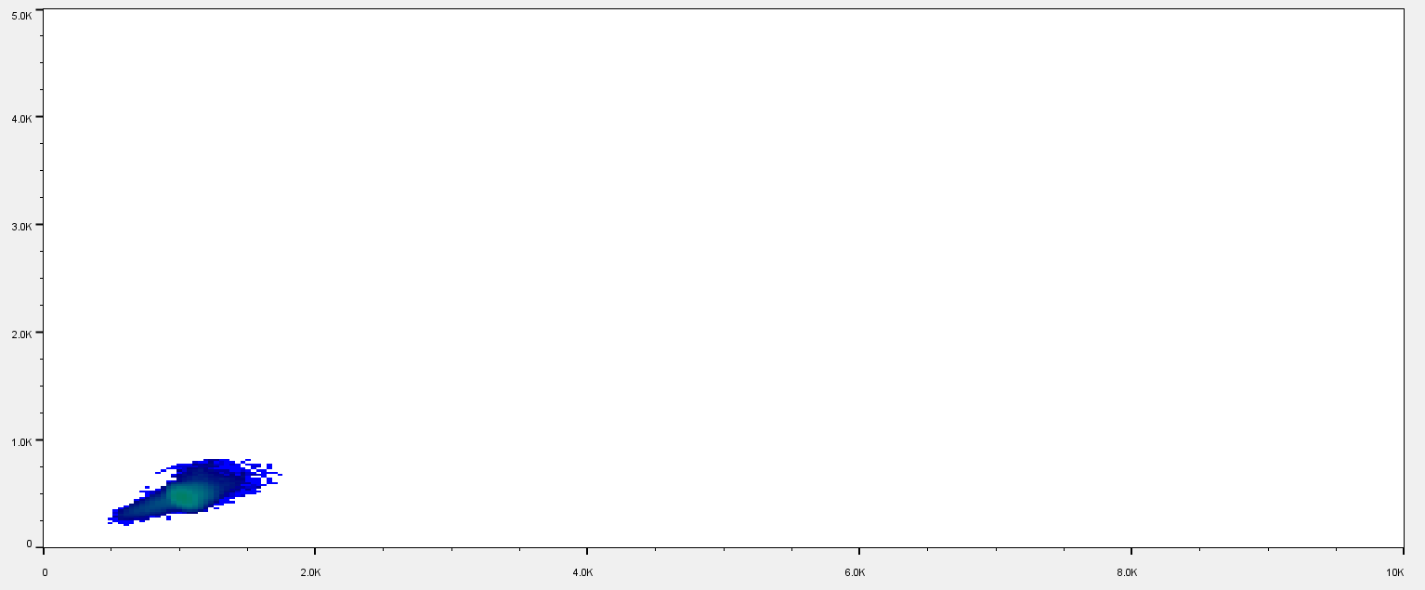

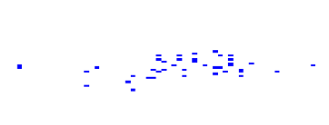
Wild Type
OFF THE CHARTS!!
MutAnts

