Slide 1
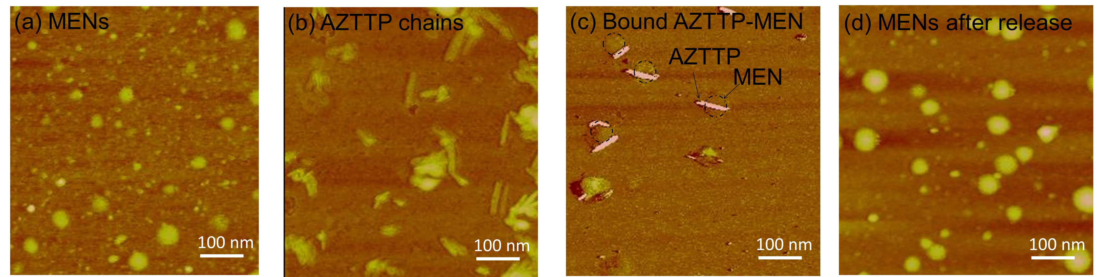
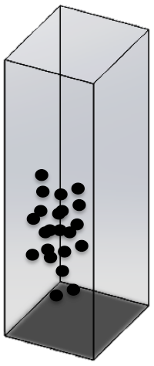
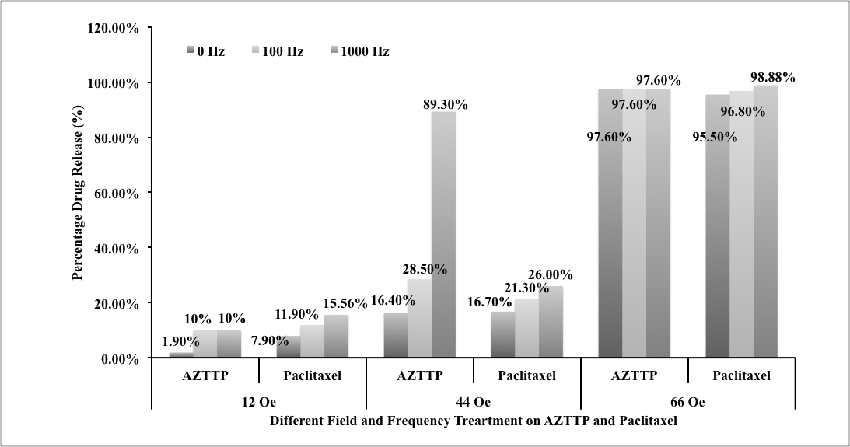
P2
AZTTP
MENs
P1
MENs after release of
therapeutic drugs
P4
P2
MENs Loaded with
therapeutic drugs
Spectrophotometry
Magnetic field treatment AC/DC

