Slide 1

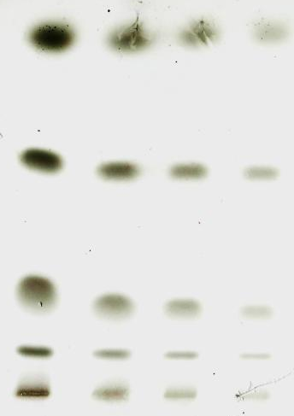
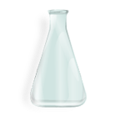
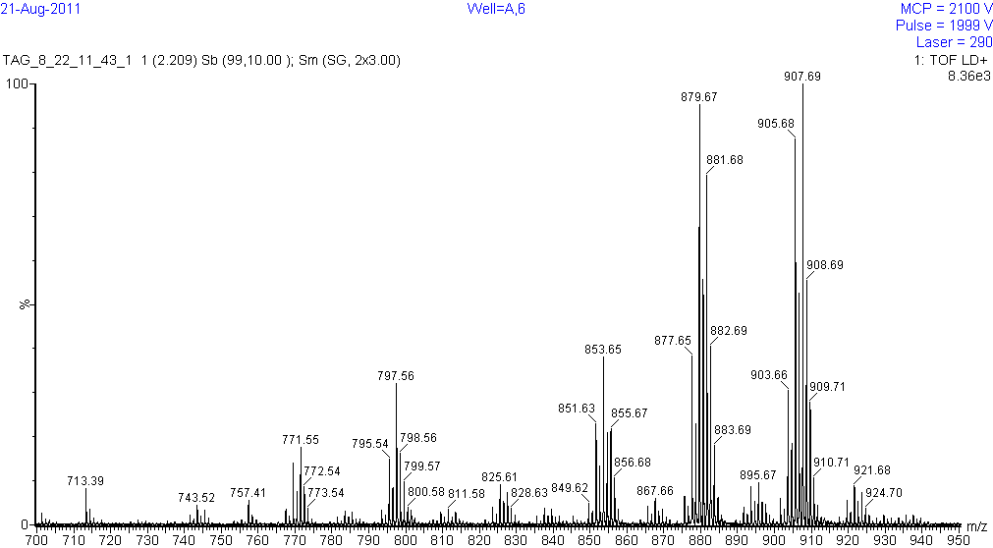
Remove Sebum
with Solvents
Separate Lipids with TLC
P1
P2
Recover Bands and Profile with MALDI-TOF MS
Process Spectra with Instrument Software and Analyze with Online Chemical Database
Composition | Composition | Mass
Na⁺TAGs |  | Na⁺TAGs
OOO, LnSS, LSO | C₅₇H₁₀₄O₆ | 907.8
LLnLn | C₅₇H₉₄O₆ | 897.7
P4, P5
P3

