Slide 1
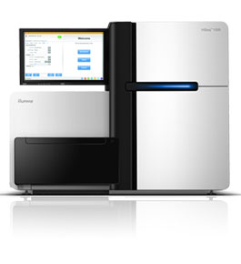
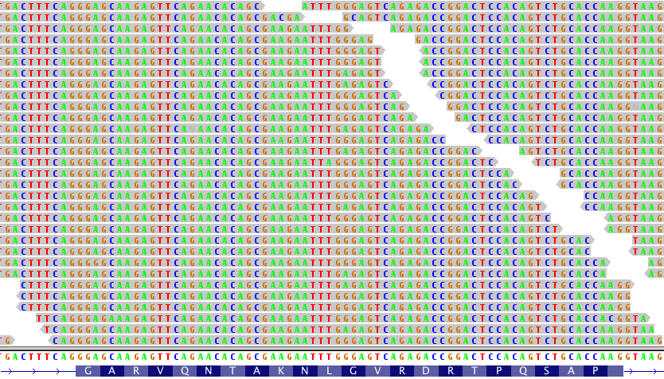
(P1)
Prepare 12-24 barcoded libraries
(P2)
(P3)
(P4)
Exon capture by
hybridization
Sequence to 500-1000x
(1 lane of HiSeq 2000 flow cell)
Align to genome
and analyze
B
Probes for 279 cancer genes
B
B
B
B
B
B
B

