Slide 1
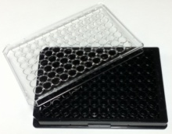
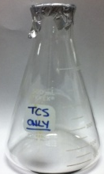
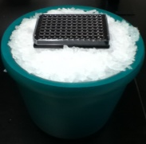
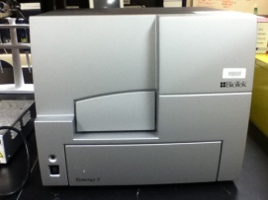
Day 1: Plate Cells
50,000 cells/well in 96-well plate;
incubate overnight 37ºC/5% CO₂
Day 2: Prepare triclosan
Heat to 50ºC for 90 min.
with stirring. UV-Vis concentration determination.
Day 2: Antigen Degranulation Experiment
IgE sensitization; Antigen stimulation
± TCS
Day 2: Calcium Ionophore Degranulation Experiment
A23187 ± TCS
Transfer aliquot of supernatant
to new plate containing
fluorogenic substrate on ice
Measure β-hexosaminidase
activity in microplate reader

