Slide 1
Notes:
The overall goal of the following experiment is to study structural changes in electrodes undergoing cycling in batteries in real time. (Intro)

Slide 2
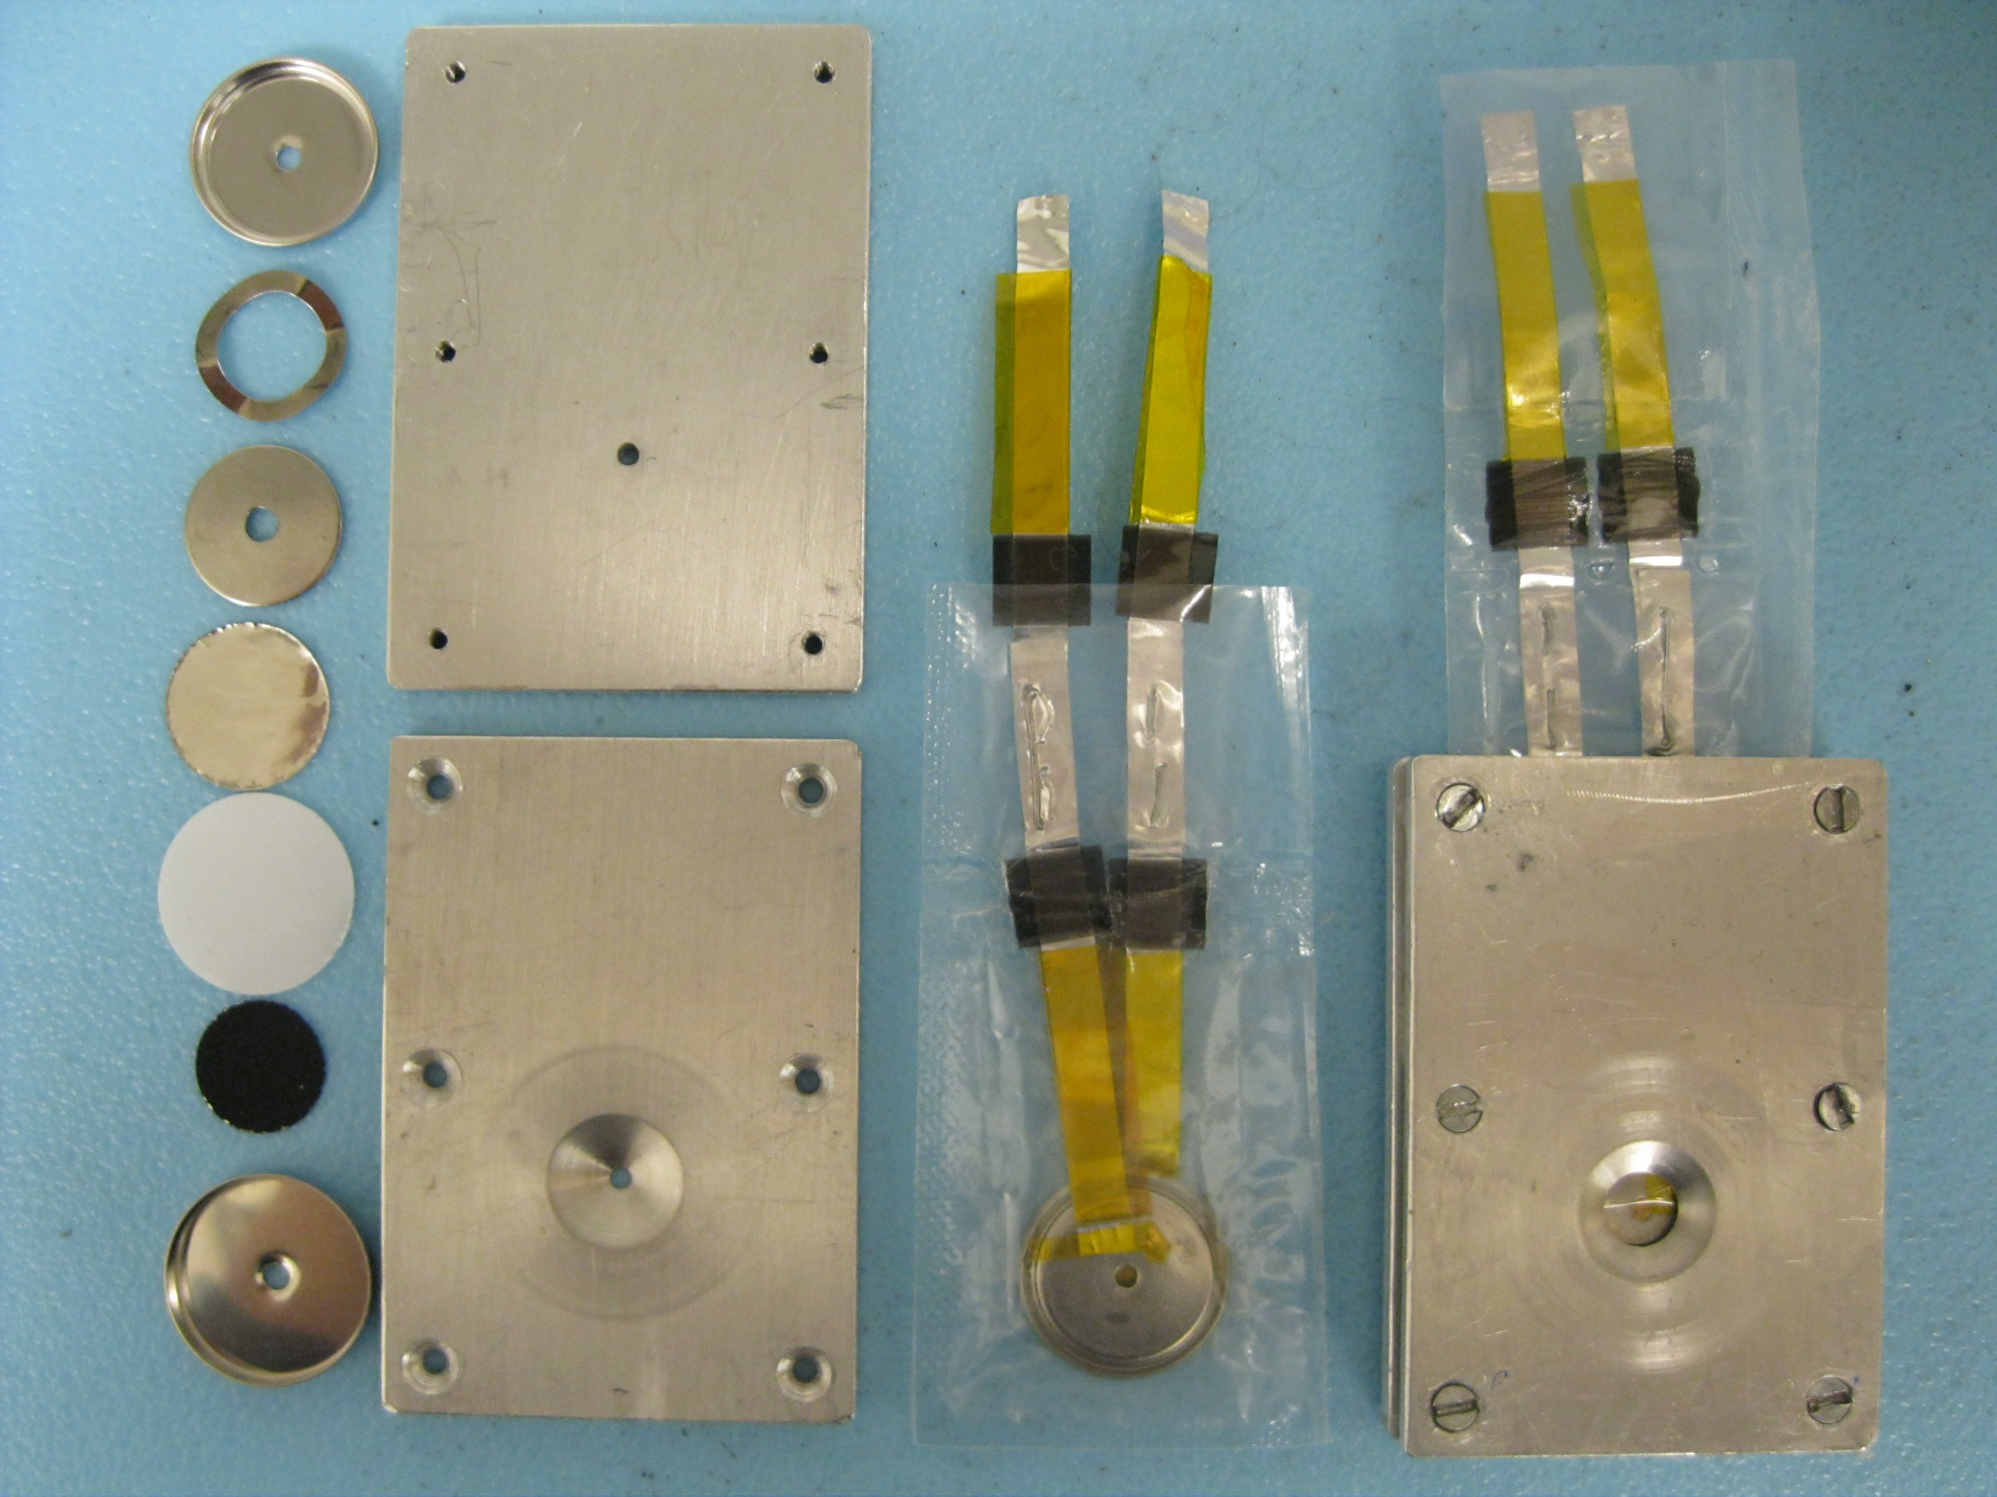
Notes:
This is achieved by assembling test cells modified so that electrode processes can be studied in the beam line at a synchrotron radiation facility, as the devices undergo charge and discharge. (P1)

Slide 3
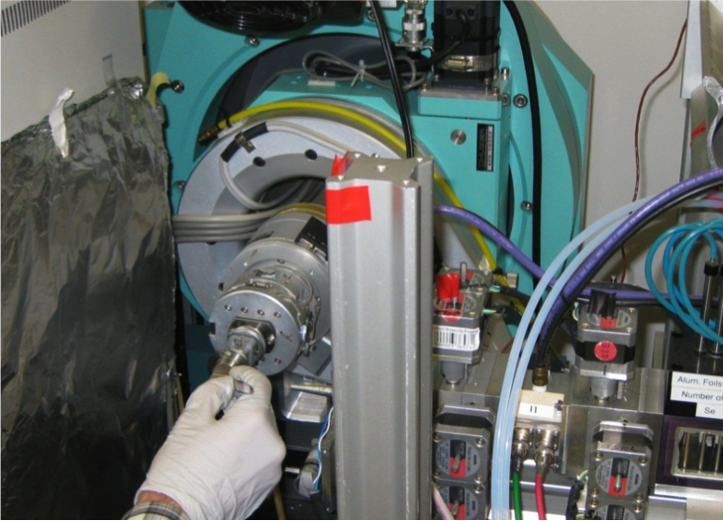
Notes:
As a second step, data is collected on the test cells at the beam line as a function of time and working conditions (for example, different voltage limits during cycling for different cells). (P2)

Slide 4
Notes:
Next, the data is processed and analyzed in order to observe the structural changes that occur as a function of state-of-charge (P3)

Slide 5
003
5% Al
104
006/102
110
Current Collector
101
018
Intensity (a.u.)
015
107
Polymer
009
113
Discharge
Charge
1
2
3
4
5
1
q (2π/d), 1/Å
Notes:
Results are obtained that provide insight into the functioning of the electrodes, including phase changes and degradation processes based on refinement of diffraction data and interpretation. (P4)

