Slide 2
q
q
q˜
χ˜⁰
g˜
q
1
χ˜⁰
1
χ˜⁰
˜_{q}
χ˜⁰
1
1
g˜
q
q
q
q
_{W} ±
_{W} ±
±
χ˜₁
0
q˜
χ˜±
χ˜⁰
χ˜₁
1
1
0
1
χ˜±
χ˜⁰
±
χ˜
˜q
1
1
χ˜
1
_{W} ±
_{W} ±
q

Slide 3
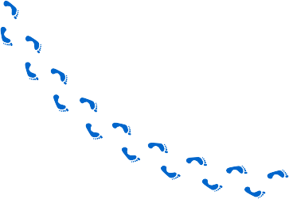
q
q
q˜
χ˜⁰
g˜
q
1
χ˜⁰
1
χ˜⁰
˜_{q}
χ˜⁰
1
1
g˜
q
q
q
q
_{W} ±
_{W} ±
±
χ˜₁
0
q˜
χ˜±
χ˜⁰
χ˜₁
1
1
0
1
χ˜±
χ˜⁰
±
χ˜
˜q
1
1
χ˜
1
_{W} ±
_{W} ±
q
Arbitrary
m₀=300, m =600
Arbitrary
10²
m₀=300, m =600
10²
1/2
1/2
Simplified Models
Simplified Models
10
10
1
1
0 200 400 600 800 1000 1200 1400 1600 1800 2000
0 50 100 150 200 250 300 350 400 450 500
Leading Jet p [GeV]
Leading Muon p [GeV]
T
T
✔

Slide 4
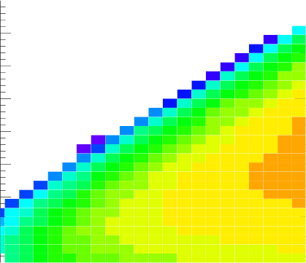
q
q
q˜
χ˜⁰
g˜
q
1
χ˜⁰
1
χ˜⁰
˜_{q}
χ˜⁰
1
1
g˜
q
q
q
q
_{W} ±
_{W} ±
±
χ˜₁
0
q˜
χ˜±
χ˜⁰
χ˜₁
1
1
0
1
χ˜±
χ˜⁰
±
χ˜
˜q
1
1
χ˜
1
_{W} ±
_{W} ±
q
Arbitrary
m₀=300, m =600
Arbitrary
10²
m₀=300, m =600
10²
1/2
1/2
Simplified Models
Simplified Models
10
10
1
1
0 200 400 600 800 1000 1200 1400 1600 1800 2000
0 50 100 150 200 250 300 350 400 450 500
Leading Jet p [GeV]
Leading Muon p [GeV]
T
T
m_{LSP} [GeV]
800
1-Step Decay, x=1/4
~g~g Production, ~g→qqW∼χ⁰
₁₀-1
Acceptance × Efficiency
1 1 ¹
1
700
1
1 muon, ≥3 jets, loose SR
s=7 TeV, MadGraph+Pythia+PGS
600
₁₀-2
500
400
₁₀-3
300
200
₁₀-4
100
0
300
400
500
600
700
800
₁₀-5
m~_{g} [GeV]

Slide 5
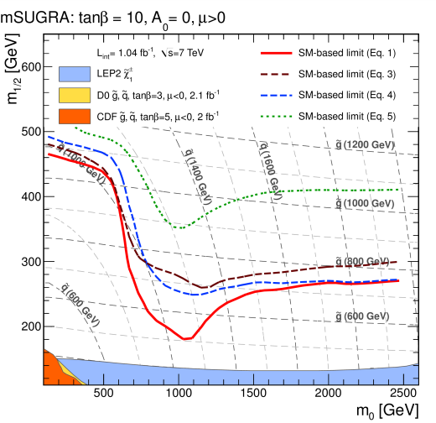
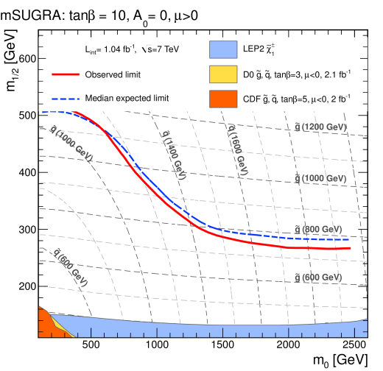
q
q
q˜
χ˜⁰
g˜
q
1
χ˜⁰
1
χ˜⁰
˜_{q}
χ˜⁰
1
1
g˜
q
q
q
q
_{W} ±
_{W} ±
±
χ˜₁
0
q˜
χ˜±
χ˜⁰
χ˜₁
1
1
0
1
χ˜±
χ˜⁰
±
χ˜
˜q
1
1
χ˜
1
_{W} ±
_{W} ±
q
Arbitrary
m₀=300, m =600
Arbitrary
10²
m₀=300, m =600
10²
1/2
1/2
Simplified Models
Simplified Models
10
10
1
1
0 200 400 600 800 1000 1200 1400 1600 1800 2000
0 50 100 150 200 250 300 350 400 450 500
Leading Jet p [GeV]
Leading Muon p [GeV]
T
T
m_{LSP} [GeV]
800
1-Step Decay, x=1/4
~g~g Production, ~g→qqW∼χ⁰
₁₀-1
Acceptance × Efficiency
1 1 ¹
1
700
1
1 muon, ≥3 jets, loose SR
s=7 TeV, MadGraph+Pythia+PGS
600
₁₀-2
500
400
₁₀-3
300
200
₁₀-4
100
0
300
400
500
600
700
800
₁₀-5
m~_{g} [GeV]

